Slide 1
Global Health Metrics, LLC
Ohio Commission on Infant Mortality
December 5th, 2019
Greg Davis, VP Commercial Operations
Robert Gillio, MD, Chief Medical Innovation Officer
Adam Perzynski, PhD, Chief Science and Strategy Officer

Slide 2
Agenda
Global Health Metrics - Company Background
Healthy Mom Health Risk Assessment
Why choose Global Health Metrics?

Slide 3
Global Health Metrics Company History
2011 - Grant awarded to Dr. Joseph Sudano by the Agency for Healthcare Research and Quality to update a health risk assessment (HRA) for use in primary care.
2012 - Healthy Life Health Risk Assessment™ released, inspired by the Healthier People Network HRA and originally developed by the Centers for Disease Control.
2015 Granted exclusive license to the HealthyLife Health Risk Assessment from Case Western Reserve University and MetroHealth, where the team developed the software.
2019 Crossed the threshold of 25000 users and more than 30 corporate partnerships.

Slide 4
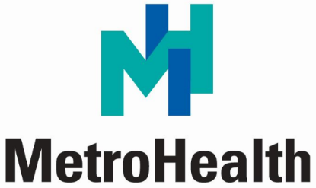
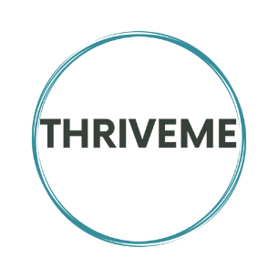
Regional, National, and International Customers & Partners

Slide 5
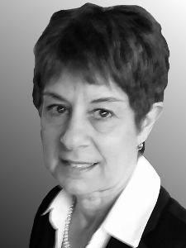
Global Health Metrics Company History
MD, MBA, 3 PhDs
90 scientific publications
$50 million in grant funding
4 exits to Fortune 500

Slide 6
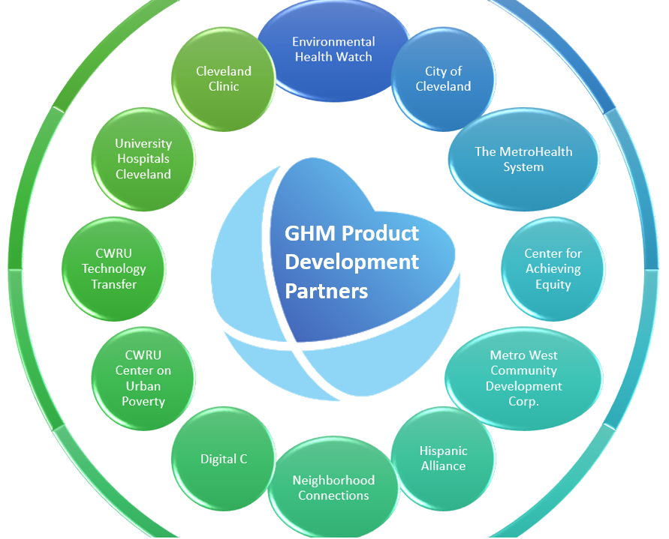

Slide 7
Our Technology
DSaaS: GHM provides data science as a service, hosted on the Google Cloud Platform (with a BAA for meeting HIPAA requirements).
APIs: GHM develops APIs for data collection, risk assessment, and analytics.
We also develop customized portals that consume these APIs.
GHM software services are designed to keep pace with rapid prototyping and release of new scientific advancements.
In 2019 we pushed more than a dozen scientific updates to the HRA software.

Slide 8
Benefits of Health Risk Assessments
Identify primary health risk factors (benefits for individuals and policy makers)
Evaluate efficacy and return on investment of health promotion policies [1]
Evidence suggests that simply taking an HRA can have a positive effect on health behavior change and health status. [2][3]
Impact of a Health Promotion Program on Employee Health Risks and Work Productivity https://journals.sagepub.com/doi/10.4278/0890-1171-22.1.45
A Return on Investment Evaluation of the Citibank, N.A., Health Management Program https://journals.sagepub.com/doi/10.4278/0890-1171-14.1.31
The Savings Gained From Participation in Health Promotion Programs for Medicare Beneficiaries https://journals.lww.com/joem/Abstract/2006/11000/The_Savings_Gained_From_Participation_in_Health.6.aspx

Slide 9
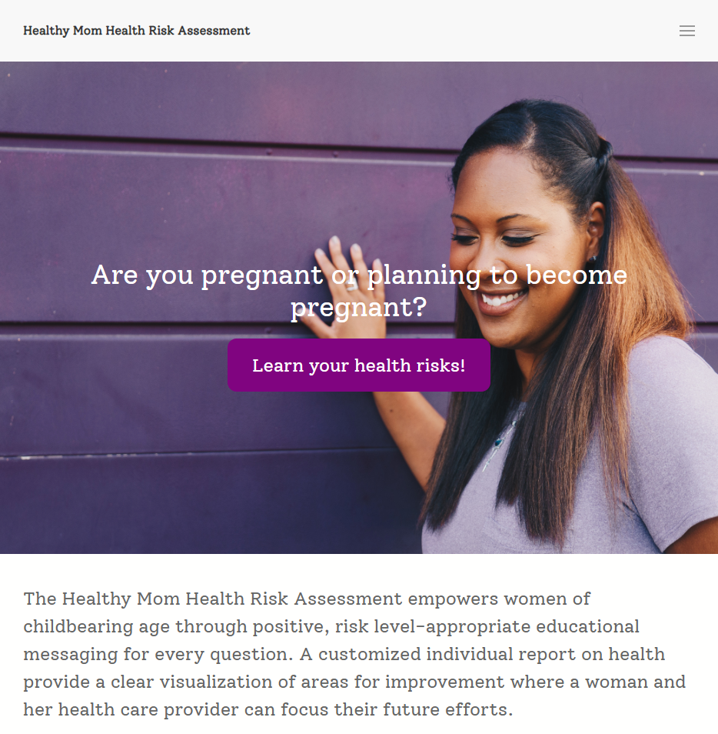
Healthy Mom HRA - Homepage
Addresses problems associated with infant mortality
Supports maternal and child health with brief screening and positive feedback
Clinically validated screening tools and messaging

Slide 10
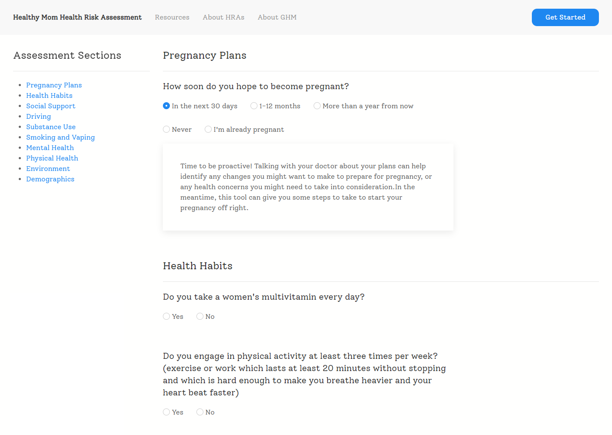
Healthy Mom HRA - Example Question

Slide 11
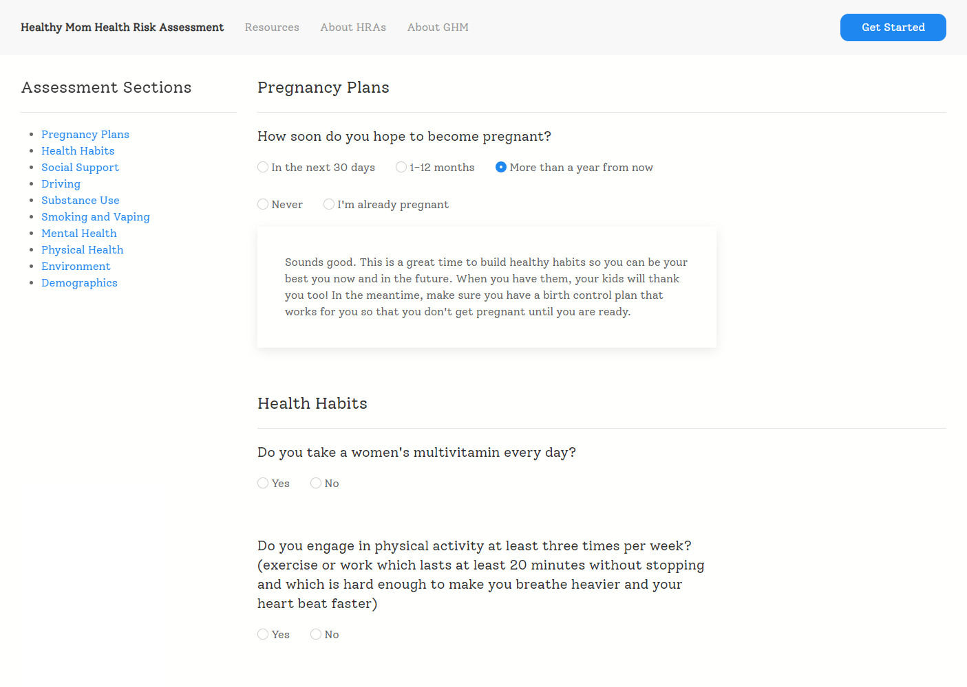
Healthy Mom HRA - Example Question
Different selections provide different immediate feedback
User choices are all considered when generating the final report

Slide 12
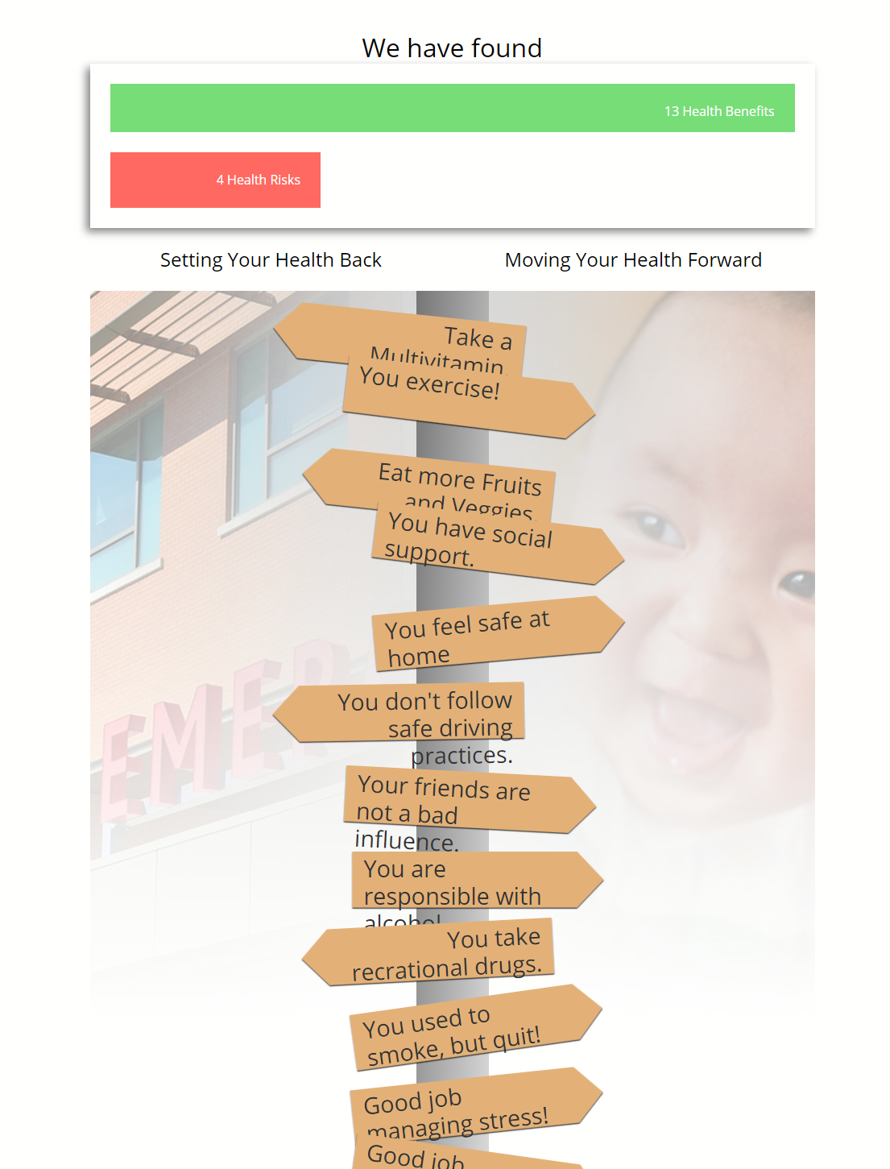
Healthy Mom HRA - Report
Final report is undergoing revisions to better align with the mission of non-judgmental health feedback
Many of these behaviors exist on a continuum, and they’re currently being presented as binary choices.
GHM is consulting with Caitlin R. Williams, doctoral student in the Department of Maternal and Child Health at Gillings School of Public Health, University of North Carolina at Chapel Hill. Her area of research is implementation strategies for evidence-based practices in underserved and marginalized communities.

Slide 13
Health and Wellness Service Connections
Report content can be localized to connect women to service agencies.
Health coaching and community health worker resources can be mobilized
Supportive, low cost mHealth solutions can be include to provide “sticky” long term engagements and promote health behavior change.
We are experienced in conducting Electronic Health Record integrations.

Slide 14
Our software can provide Ohio women with actionable information that can help to avoid some of the most disastrous outcomes that are far too common in nearly every Ohio community.

Slide 15
Questions?
How can we collaborate with the Ohio Commission on Infant Mortality to help Ohio moms live healthier?

Slide 16
Global Health Metrics, LLC
Ohio Commission on Infant Mortality
December 5th, 2019
Greg Davis, VP Commercial Operations
Robert Gillio, MD, Chief Medical Innovation Officer
Adam Perzynski, PhD, Chief Science and Strategy Officer
Demo

