Slide 1
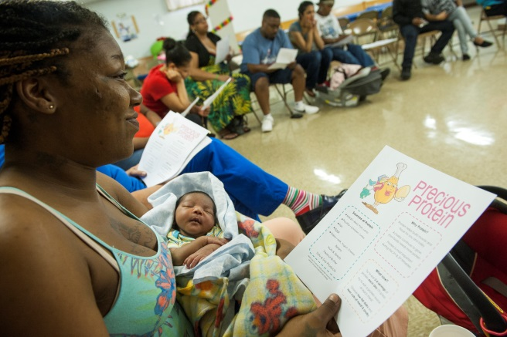
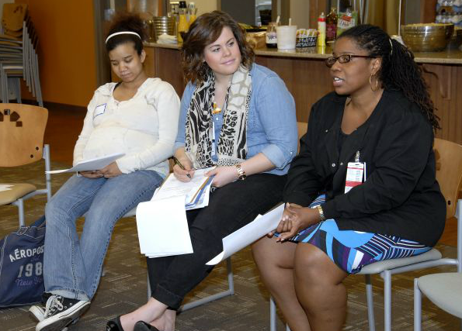
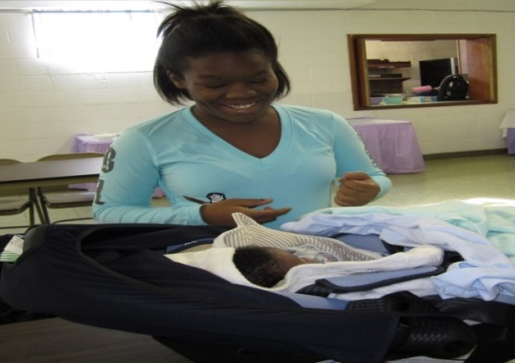
..an Ohio State University community program, empowers pregnant women in high risk neighborhoods to deliver healthy babies and reduce racial disparities in infant mortality.
Moms2B

Slide 2
Goal: To explain Moms2B and the Social Determinants of Health
Background
Infant Mortality in Ohio and Columbus
Moms2B Program
Whom do we serve?
What are the social determinants of health?
What are our results?
What comes next

Slide 3
USA & Ohio Infant Mortality Rate (IMR) 2000-2010
IMR is the number of live born infants dying in the first year of life per 1000 live births
From 2000-2010:
Ohio’s Overall IMR, 3% worse
USA Overall IMR, improved by 11%
Healthy People 2020 goal for Infant Mortality: 6/1000

Slide 4
Infant Mortality by Race Columbus compared to NYC
March of Dimes PeriStats 2011-2013 accessed November 2015

Slide 5
Opportunity for Intervention:
145 babies died in Columbus in 2014
105/145 neonatal deaths
22/145 sleep related
18/145 other causes
Birth
28 Days
1 Year
Neonatal
Death
Post-Neonatal
Death
Anomalies
Preterm births
About 2/3 of infant deaths
Sudden Unexpected Infant Deaths
About 1/3 of infant deaths
Infant Death
Adapted from Dr. Arthur James
Notes:
So let’s look at the opportunities for intervention. Most of the infant deaths occur in the first month and they are associated with preterm births and congenital anomalies. But early preterm births are the most significant driver of African American baby deaths. In the post neonatal period, sudden unexpected infant deaths, or SIDS sleep related infant deaths, again disproportionately affecting African American's and are potentially preventable. Columbus had 18,721 births last year, and 145 infant deaths; 105 of those losses were neonatal; and after the first month, there were 23 sleep related deaths, the rest were from other causes.

Slide 6
OHIO

Slide 7
Medical Care
First Trimester Prenatal Care, Progesterone, Rx for hypertension, anemia, asthma, mental health; High risk Pregnancies
Post Partum LARC,
Breastfeeding
Smoking Rx

Slide 8
Early Prenatal Care – First Trimester
Lower SES have later access
Socioeconomic status
1- Socioeconomic status (SES) was defined by median household income and attainment of a bachelor degree by individuals 25 years of age or greater
Sources: Socioeconomic status calculated from American Community Survey 5 year estimates (2007-2011)
Ohio Risk Factor Data from Ohio Department of Health Vital Statistics Birth Files (2007-2011)
United States Estimates from National Vital Statistics System Birth Data (2007-2010)

Slide 9
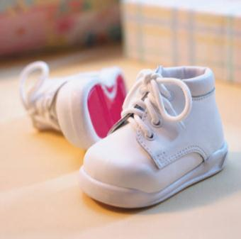
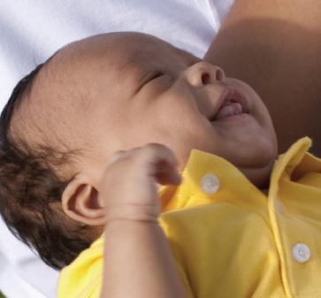
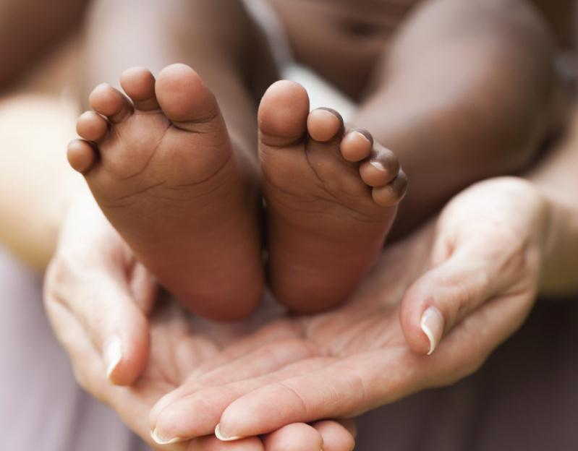
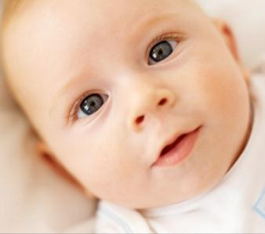
CelebrateOne
Source: CelebrateOne
Notes:
-- That video was shown at our first meeting and will be shared when we present on the TF out in the community
-- Does a nice job of setting up the charge from Council president ginther and the case for change
-- Since September, I have been working closely with a colleague at nationwide children’s hopsital and a communications team at Paul Werth to launch and now support the work of the task force
- I am so pleased ot have the opportunity to present a brief update on this work to all of you!

Slide 10
Moms2B
Began Sept 2010 with an OSU Grant to Dr. Pat Gabbe
In 2014 became an Ohio State University woman’s health program in the Dept of Ob-Gyn.
Includes a multidisciplinary team: Social Workers, a Community and Family Advocate; Infant Mental Health Specialist; Medical Dietitians, Obstetricians, Pediatricians, Students and Volunteers.

Slide 11
Moms2B addresses the social determinants contributing to infant mortality
Housing
Food
Transportation
Education
Neighborhood Crime
Unemployment
Emotional Stress
Adverse Childhood Experiences (ACE)
Notes:
Service and Research: Our moms sign a consent to have their chart information in a data repository maintained on paper charts, then inserted into RedCap at the Center for Clinical and Translational Science CCTS; Diet data at the clinical research center
Population Health….small area analysis: Kirwin Institute and Columbus Public Health
Analysis of individual factors: standard questionnaires guide service and generate pathways
Teaching: social work students and medical students, medical dietetic
Service: community services, Columbus Public Health, WIC, Mount Carmel Health; Center for New Directions, Planned Parenthood, Urban League, Mid Ohio Food Bank
Many Thank You’s “I don’t know what I would have done without you?”

Slide 12
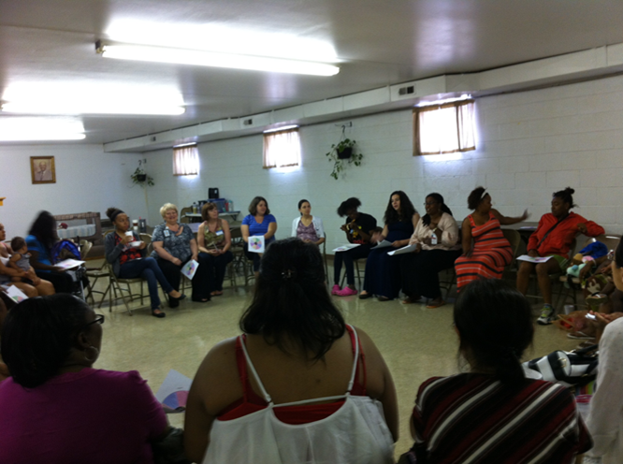
Moms2B Sister Circle

Slide 13
Moms2B
Weekly for 2 hours at each of 4 locations
Group Teaching:
Nutrition and Stress Reduction
Breastfeeding
Pregnancy topics
Safe Sleep
Reproductive health
Access to EpicCare
Individual weekly check list for personal needs.
Individual needs generate a pathway
Postpartum:
Hospital visit
Nurse home visit
Parenting group
Weinland Park
OSU East
Mt. Carmel West
Primary One South

Slide 14
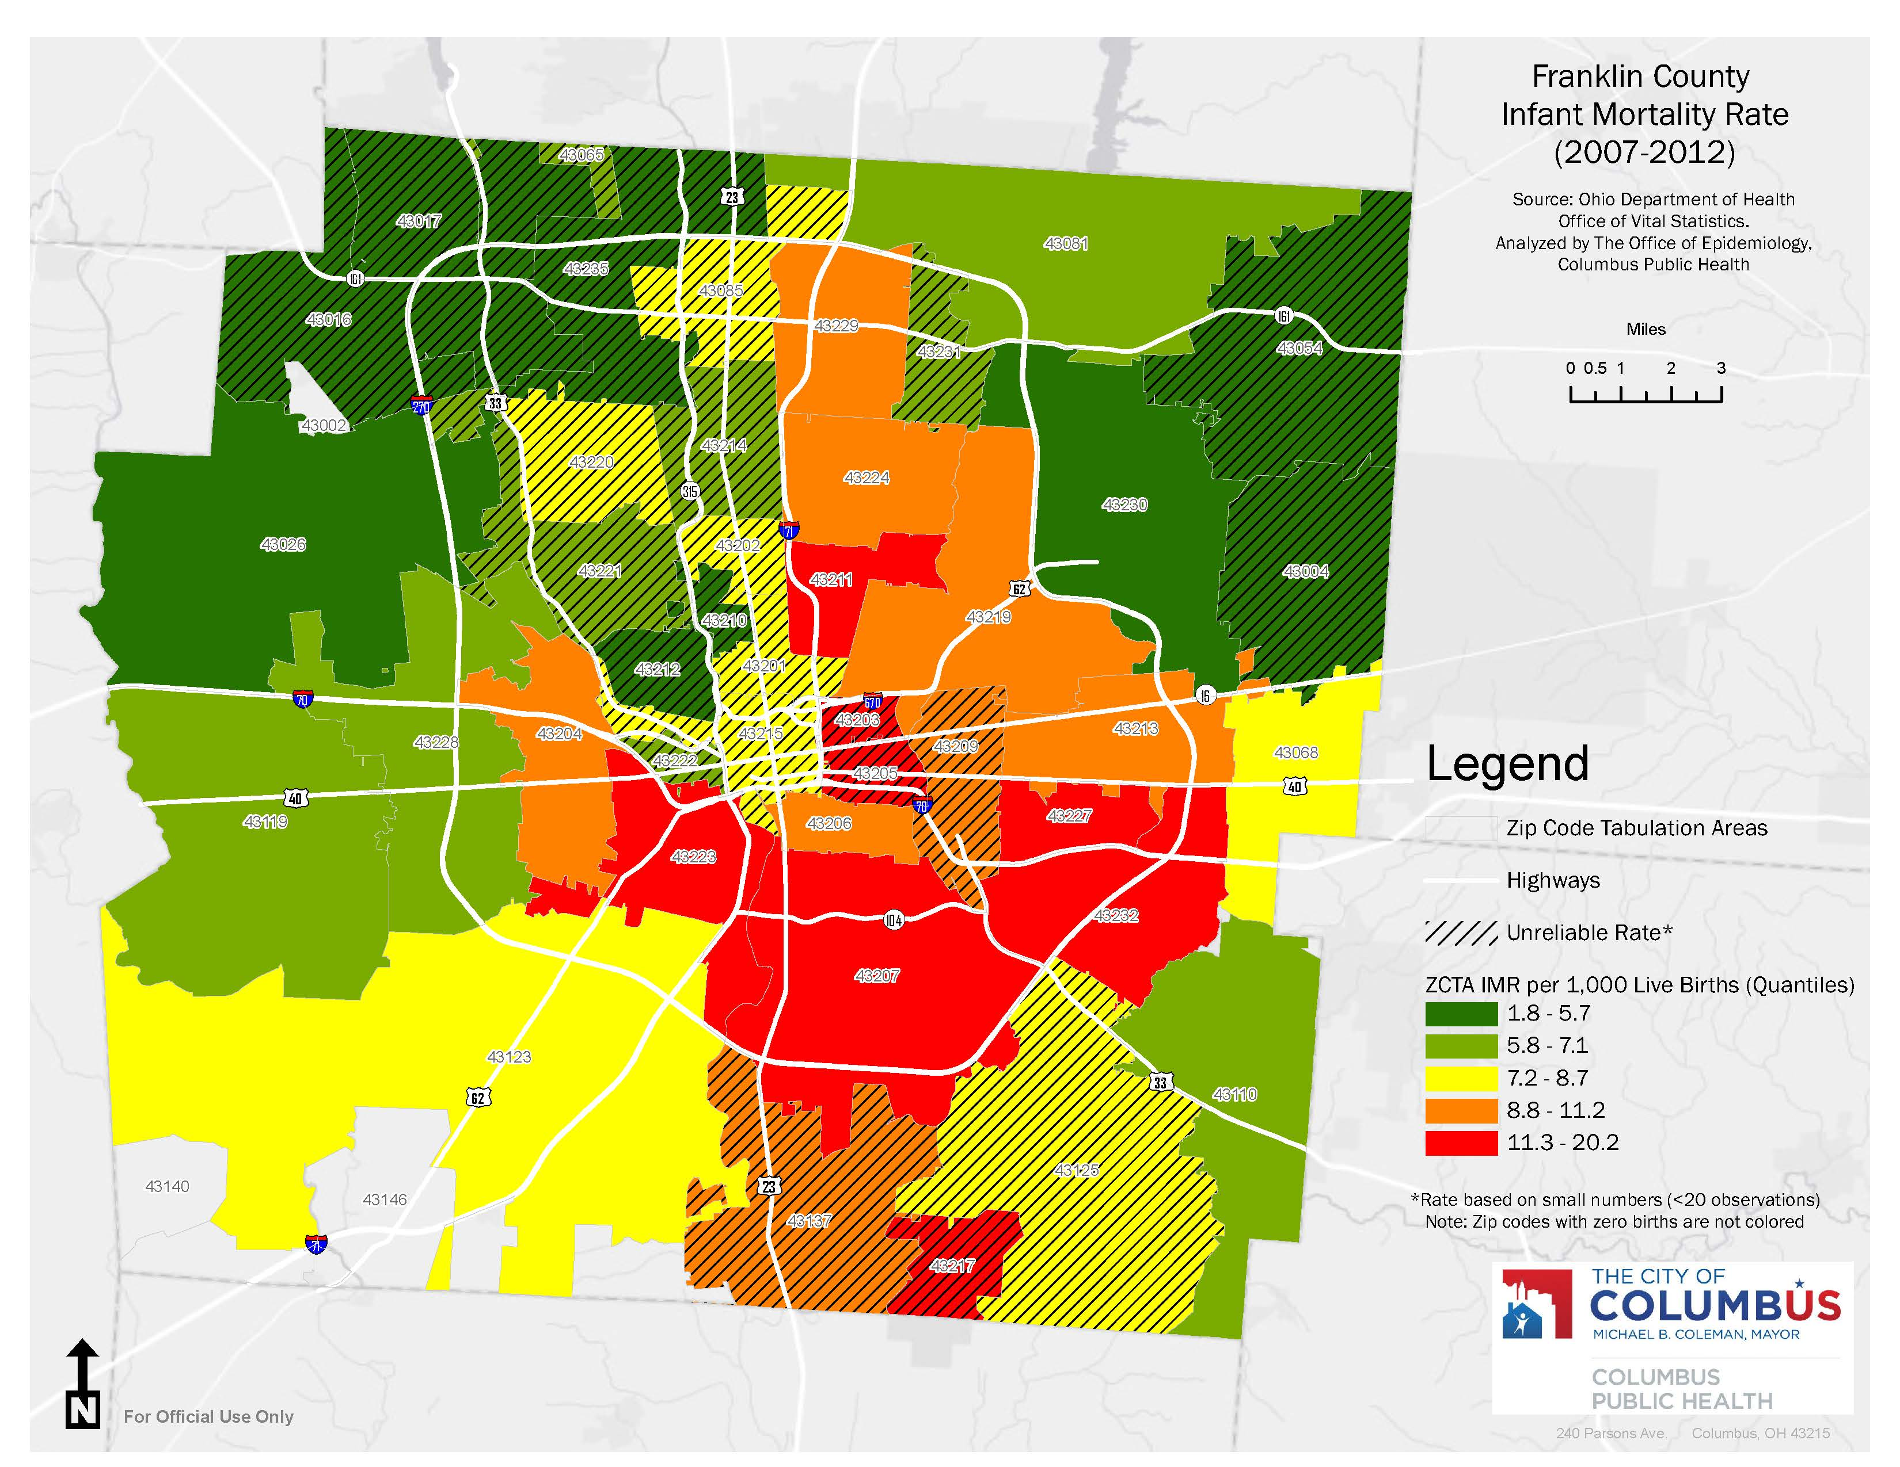
New pregnant attendance at each Moms2B site
Total = 570 thru 6-31-2015
Weinland Park N=216 began 9-2010
OSU East N=263 began 11-2011
Mount Carmel West
N=54 began 4-2014
South Parsons
N=37 began 7-2014
Notes:
Our Weinland Park zip code has changed from orange to yellow. Still too many red areas.

Slide 15
Moms2B Demographics
Moms2B
Average age | 23 (14-41)
% Monthly Income < $800 | 78%
Prior Preterm Birth | 16%
Anemia | 23%
Asthma | 20%
Hypertension | 11%
Diabetes | 5%
%
Notes:
Our moms range from 14 to 41 years old; we welcome any pregnant woman in the neighborhood; most of our moms have very little income; less than $800 per month; they have food stamps, but food stamps won’t buy diapers, or laundry soap or other household essentials; 16% have had a preterm birth, and many have anemia, astham, hypertension and some have diabetes, both type I and 2. Recently our demographics have shifted from almost totally African American to 69% AA. Almost half have two or more children, have not completed high school and are at risk for depression, using a depression screening tool.

Slide 16
Moms2B Pathways for 113 Moms July 2014-Jan 2015
Notes:
Tanikka developed the pathways, a structured way to document the needs and the success in overcoming the barrier; emotional health and depression are highest in needs, but look at education most of our moms want to finish their education. Of most concern is unstable housing. This impacts school attendance, and creates high levels of stress. We now recruit from the new Homeless Shelter on the West Side. As you will see later, our breastfeeding pathway and providing a safe sleep environment with Pack N Plays is paying off with reduced infant deaths. Likely the reproductive health and birth control we now have access to LARC Long Acting Reversible Contraception pays huge dividends, as of yet not well measured at the population level.

Slide 17
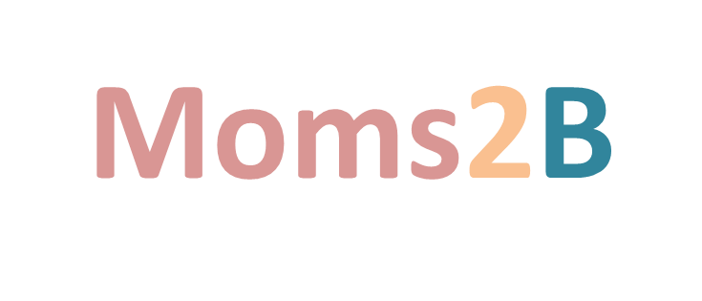
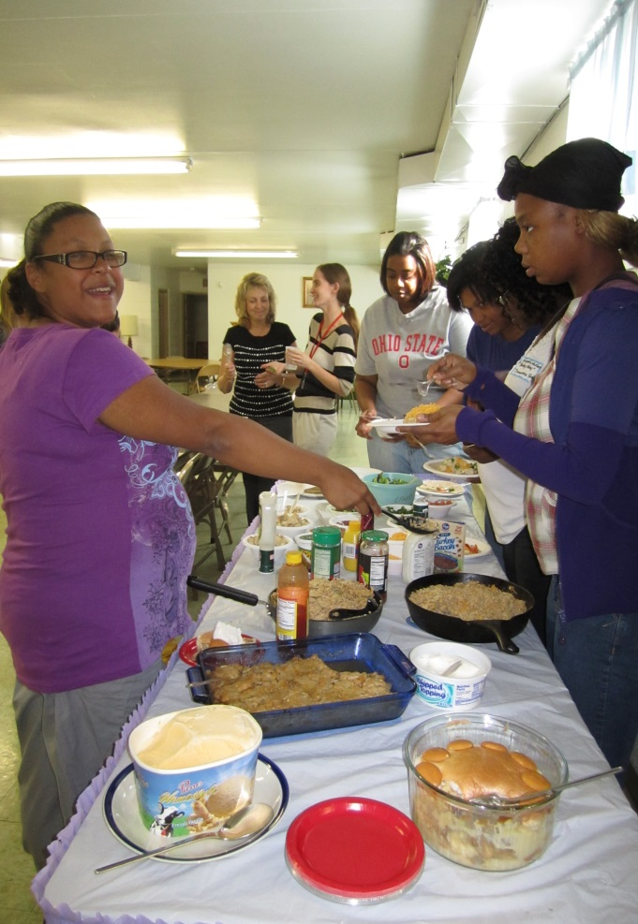
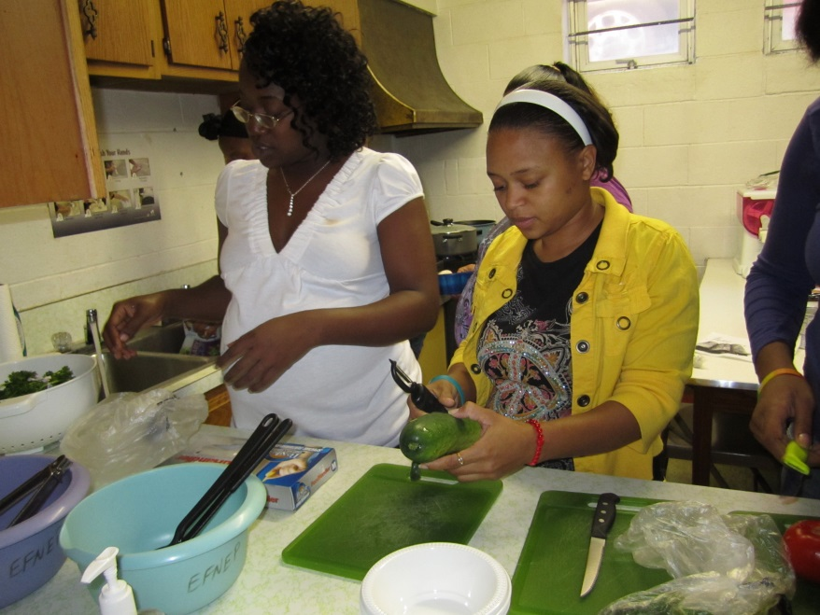
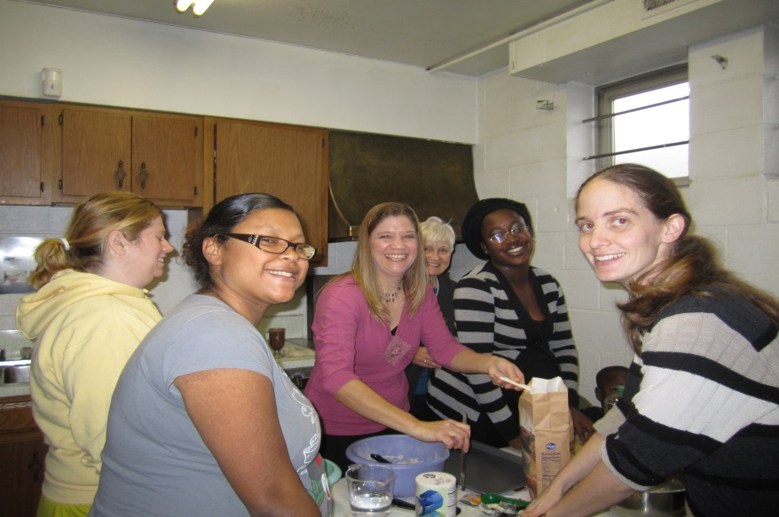
Caring through FOOD!
Taking care of Mom so she can take care of Baby.

Slide 18
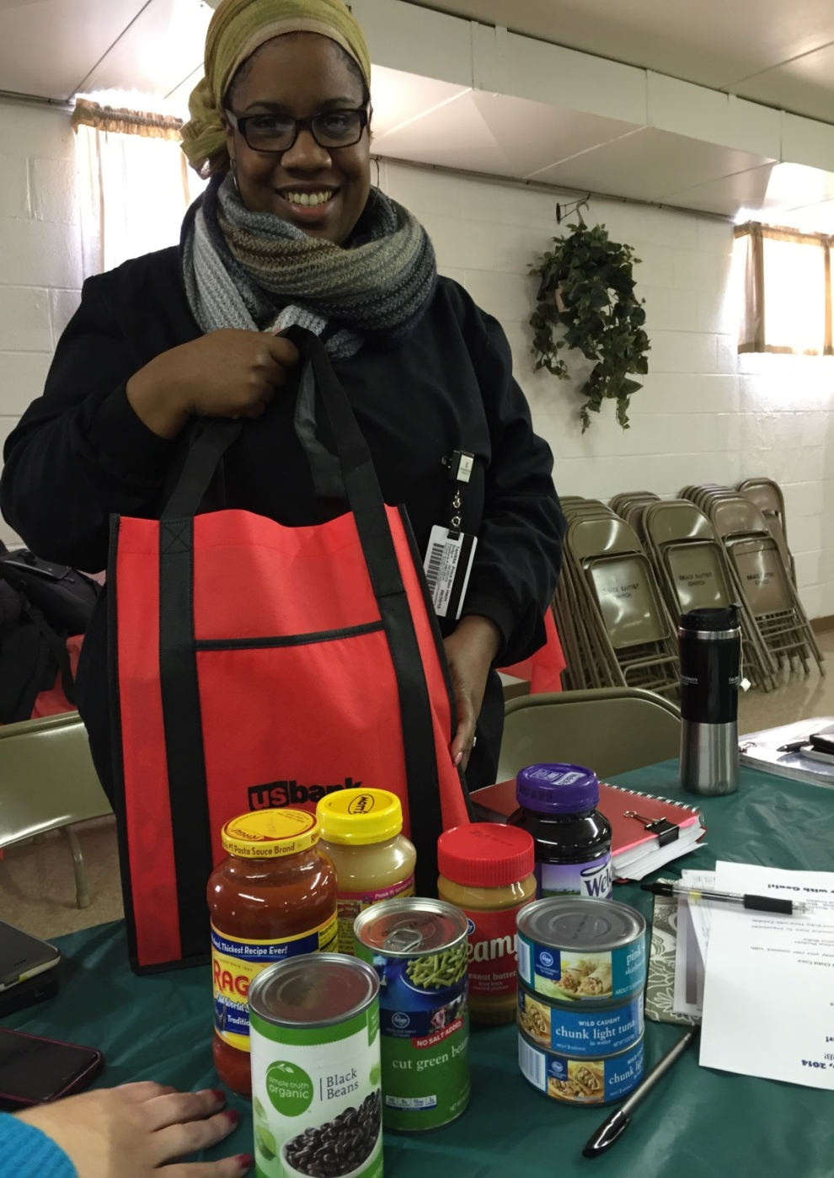
Tanikka Price, Moms2B Community Advocate with Emergency Food Bag

Slide 19
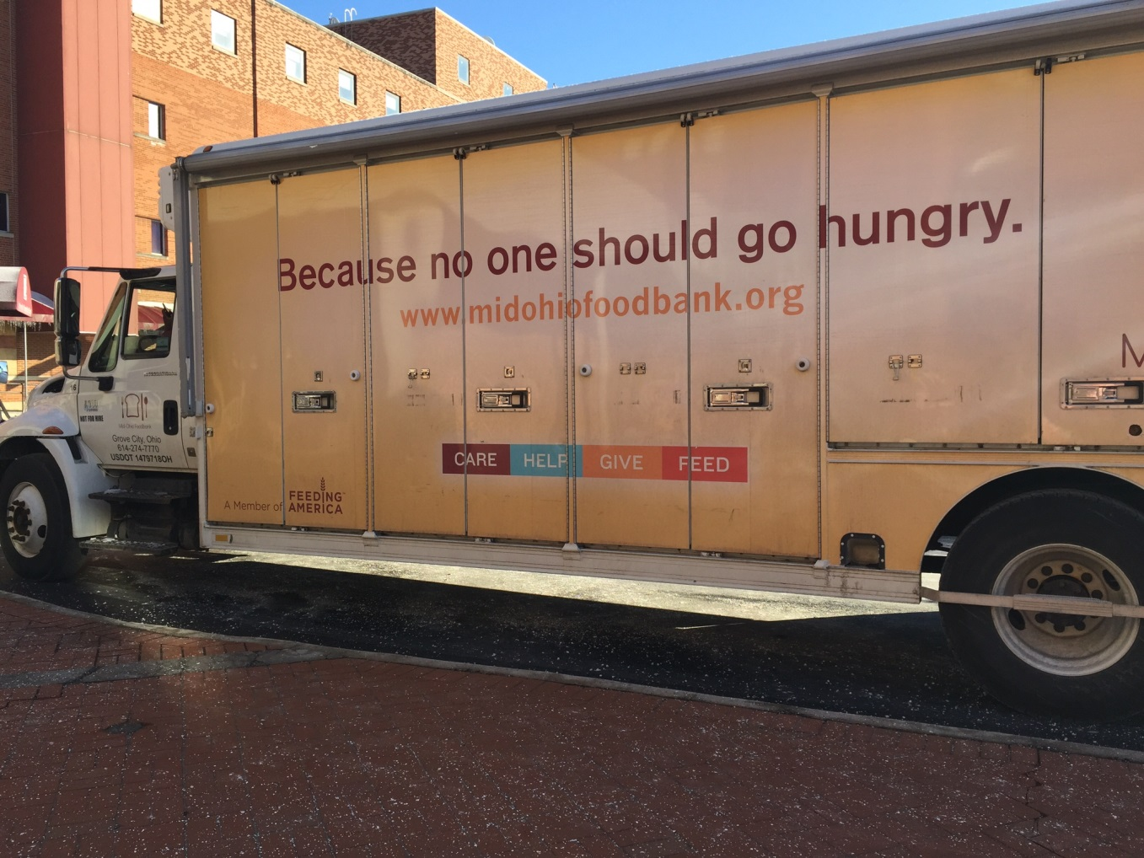
Moms2B University Hospital East Wallace Auditorium
MidOhio Food Bank Feb 2015
Notes:
Mid Ohio Food bank is an important community partner, they have come to Moms2B Weinland park for the past five years. This month, added OSU East to their delivery service. Fantastic fresh fruits, vegetables and staples once a month.

Slide 20
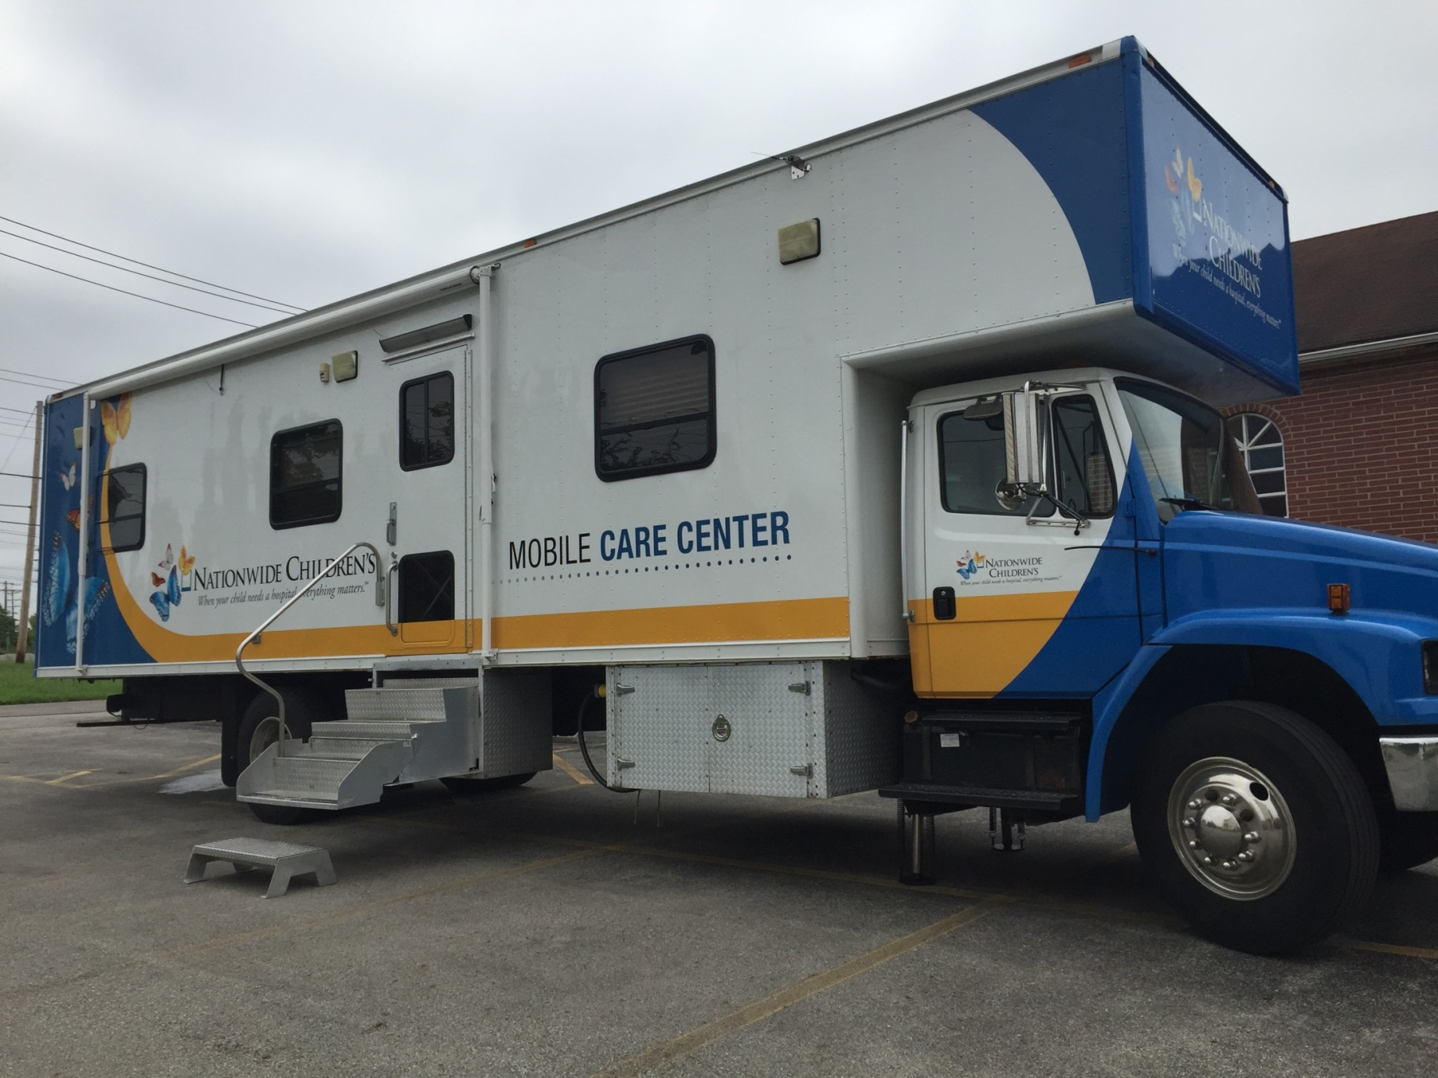
Monthly Well Child Check-ups for Moms2B Babies

Slide 21
IMR in Weinland Park Reduced Before Moms2B=15/1000 After Moms2B = 3/1000
8 infants died
Before Moms2B 8 infant deaths/ 529 births (5 years)
After Moms2B 1 infant death/328 births (4 years)

Slide 22
Moms2B had 26% fewer premature babies and 17% fewer low birth weight babies than expected
15%
12%

Slide 23
Breastfeeding Initiation Rates

Slide 24
1st Trimester Smoking in Weinland Park
Smoking among pregnant women decreased from 30% to 7%
%
*Data from Columbus Public Health

Slide 25
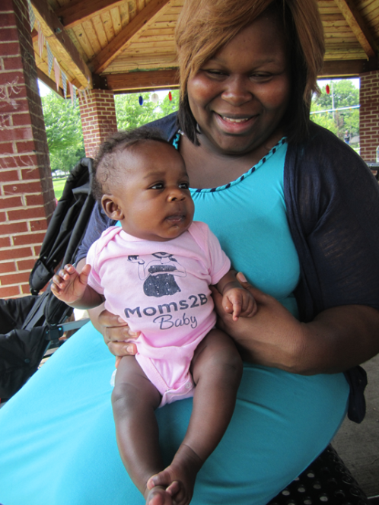
Moms2B Summary
We can build trust in neighborhoods with long term commitment
Women living in poverty have incredible resiliency
What's Needed:
Social Determinants:
More stable housing and healthy food
More transitional jobs; transportation
More fathers involved
Medical System:
More prenatal care clinics
More integration with community program.
Together we can save babies’ lives

