Slide 1
Ohio Commission on Fatherhood Father Facts: The Important Role Fathers Play in Their Children’s Lives
Kimberly A. Dent, Executive Director Ohio Commission on Fatherhood, Ohio Department of Job and Family Services www.fatherhood.ohio.gov

Slide 2
Ohio Commission on Fatherhood – In State Law Since 1999 (ORC 5101.34)! Overall Focus
Increase public awareness of the critical role fathers play in their children’s lives
Increase father readiness by preventing premature Fatherhood
Promote fathers’ involvement in their children’s schools
Increase employment for low-income fathers
Funding Opportunities to Develop fathers’ relationship skills in order to strengthen their parenting, co-parenting and employment prospects

Slide 3
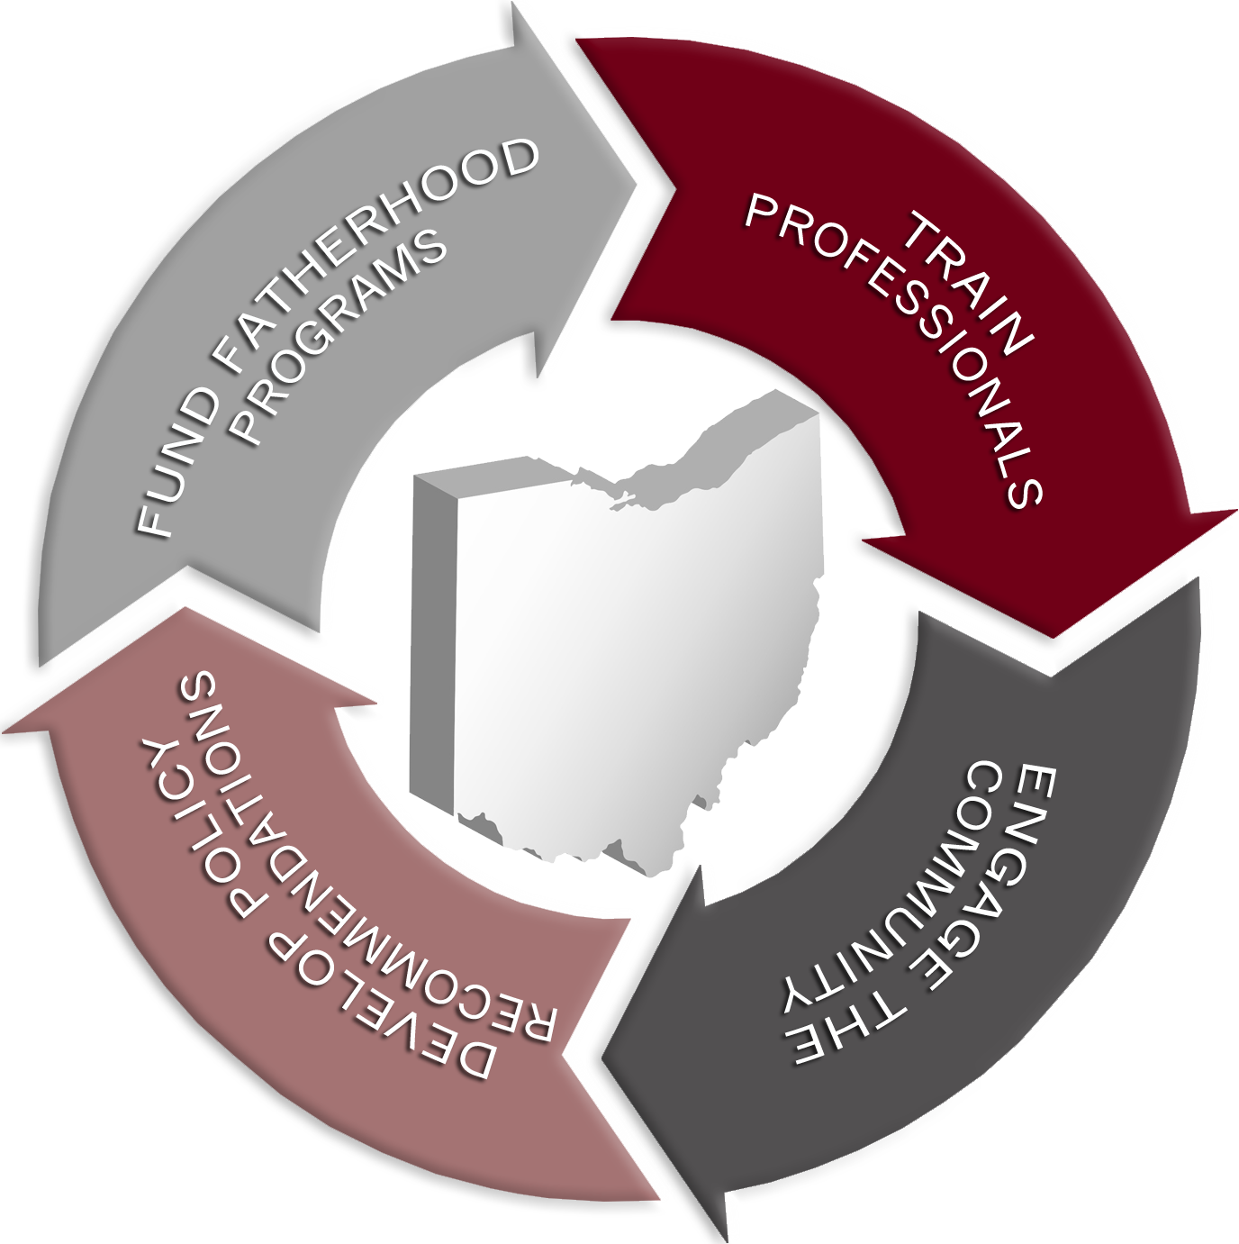
What is the Purpose of the Ohio Commission on Fatherhood?

Slide 4
The History of the Ohio Commission on Fatherhood
The Ohio Commission on Fatherhood – Bipartisan Commission 20 Commissioners representing various branches of government and state departments
2 Senators (Democrat and Republican)
4 Members of the House (2 of the 4 must be from legislative districts that include a county or part of a county that is among the 1/3 of counties in the state with the highest number per capita of households headed by females)
Designee from the Governor’s Office
Representative from the Ohio Supreme Court
Five members from the public appointed by the Governor

Slide 5
The History of the Ohio Commission on Fatherhood
Director of Ohio Department of Job and Family Services
Director of the Ohio Department of Health
Director of the Ohio Department of Education
Director of the Ohio Mental Health and Addiction Services
Director of Ohio Rehabilitation and Correction
Director of Ohio Department of Youth Services
Director of Families and Children First Council

Slide 6
Healthy Responsible Fatherhood
Father as Provider
It is absolutely necessary that responsible parents be financially accountable to their children:
Shelter
Clothing
Food
Health care
Entertainment
Miscellaneous
With dad’s involvement, engagement and support, his child is 4x less likely to live in poverty…………………
(National Fatherhood Initiative Father Facts, 7th Edition)

Slide 7
Healthy Responsible Fatherhood
However, there is much more to dad than $
Data and Research Show:
Father presence/involvement/engagement in his child’s life reduces:
Youth alcohol and drug use (Opioid Epidemic)
Teen Pregnancy – 7x less likely to become pregnant as a teen
Infant Mortality – 2x less likely his baby will not reach his/her first birthday
Child abuse and neglect
(National Fatherhood Initiative, Father Facts 7th Edition)

Slide 8
Healthy Responsible Fatherhood
Data and Research Show (continued):
Father presence/involvement/engagement in his child’s life reduces:
Youth behavioral problems
Youth academic challenges – 2x less likely to drop out of high school
Likelihood of committing a crime
Likelihood of going to prison
Childhood obesity – 2x less likely to suffer from obesity
The Cost of Father Absence is Apparent – increases taxpayer dollars, jeopardizes the well-being of society, puts at risk the future of this nation
(National Fatherhood Initiative, Father Facts 7th Edition)

Slide 9
Ohio Commission on Fatherhood TANF Funded Grantees – Service Areas
Action for Children
Delaware, Franklin and Licking
Early Resource Childhood Center
Stark and Summit
Forever Dads
Morgan, Muskingum and Perry
Passages
Lorain and Portage
Talbert House
Butler, Hamilton and Warren
Parenting (evidence-based Fatherhood curricula), Co-parenting/Healthy Relationship, Economic Stability)

Slide 10
ETO – Efforts to Outcomes
Process to include:
Intake/Characteristics Survey
IPV (Intimate Partner Violence) Screening
Pre Test
Post Test
Child Support Payment Analysis
Qualitative Interviews with participants as well as program case managers
SFY 2018 Annual Report on the OCF Website at:
www.fatherhood.ohio.gov
SFY 2019 Annual Report Due December 31, 2019

Slide 11
Systems can Help Dad Support Mom
Fathers as Protective Factors
Support for expectant mom – Healthy Birth Outcomes
Reduce Stress
Encourage Smoking Cessation
Provide Healthy Meals
Travel to OB Appointments
Birth Education Classes
Safe Birth Spacing (Wait at least 18 months – 24 months between births)
Boot Camp for New Dads (three-hour hospital-based class)

Slide 12
Infant Mortality Prevention/Fatherhood
Support for Infant
Encourage mom to breastfeed (Breast for Success Program) – Ensure mom remains hydrated and healthy (Allow her to rest)
Safe Sleep (ABC’s – Alone, Back, Crib) D – Don’t Smoke in baby’s environment
Financial Support, to include Child Support (Basic Needs) and Healthcare Coverage
Ensure Pediatric appointments are kept
Help with other little ones and household responsibilities
* A Healthy and Responsible Father = A Protective Factor

Slide 13
Pilot Project – Moms2B/Dads2B Phase II
Deliverables
Safe Sleep
Breastfeeding
Smoking Cessation
Safe Birth Spacing
Financial Education
Programming – Outcome Measures = Healthy Birth Outcome and Infant’s 1st Birthday

Slide 14
June is Responsible Fatherhood Month in Ohio 2019
Governor DeWine and Lieutenant Governor Husted declared June 2019 – Responsible Fatherhood Month in Ohio
1. Fathers are honored and celebrated throughout Ohio
2. Fathers have a moral and economic responsibility to provide financial support for their children
3. Organizations must invest resources and tools to assist fathers with being better parents partners and providers
4. The Ohio Commission on Fatherhood’s funded grantee programs focus service delivery on low income fathers and families by meeting them where they are, to include birthing hospitals, schools, churches, prisons, human and social services programs, etc.
Children are more likely to succeed and experience better emotional, social and economic outcomes with healthy, engaged and empowered fathers in their lives. For more information on the Ohio Commission on Fatherhood, please visit www.fatherhood.ohio.gov. Please like and follow us on Facebook and Twitter

Slide 15
Questions and Answers

Slide 16
Contact Information: Kimberly A. Dent, Executive Director Ohio Commission on Fatherhood Kimberly.dent@jfs.ohio.gov 614-752-0583 You’ve Been a Delightful Audience!!!!!!!!

