Slide 1
Early Childhood Race & Rural Equity

Slide 2
WHAT WE DO
Advance quality early childhood systems in Ohio by engaging, educating and mobilizing diverse stakeholders and strategic partners to promote data-driven and evidence-based early childhood policies.
Notes:
Data, policy analysis, advocacy, elevating and convening local work

Slide 3
Mission-Driven Leadership
SHANNON JONES
Executive Director
sjones@groundworkohio.org
LYNANNE GUTIERREZ
Policy Director & Legal Counsel
lwolf@groundworkohio.org
JULIA HOHNER
Communications & Policy Associate
jhohner@groundworkohio.org

Slide 4
Engaged Steering Committee
Learn to Earn Dayton
Success by 6
Summit Education Initiative
PRE4CLE
Corporation for Ohio Appalachian Development
Ohio Chapter, American Academy of Pediatrics
Ohio Child Care Resource and Referral Association
Children’s Defense Fund
Voices for Ohio’s Children
Ohio Association of Child Care Providers
Ohio Association for the Education of Young Children
Ohio PTAs
Ohio Head Start Association
Thomas B. Fordham Institute
Action for Children
Toledo Public Schools
Mary’s Little Lambs Childcare & Preschool
Upper Arlington Schools
Invest in Children
Cincinnati Early Learning Center
LGA Consulting, LLC
Creative World of Child Care, Inc.
Worthington City Schools
Knox County Head Start, Inc.
OSU Extension

Slide 5
New Approaches for Ohio’s
Most Vulnerable Children

Slide 6
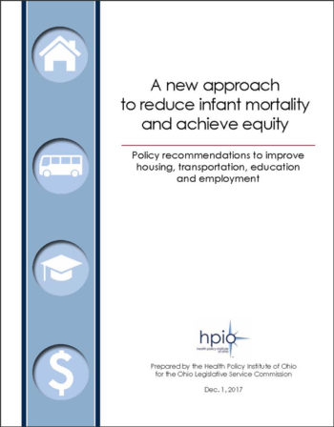
Infant Mortality Commission Recommends Study of New Approaches
Notes:
Social determinants of health. Medical care is necessary but not sufficient.

Slide 7
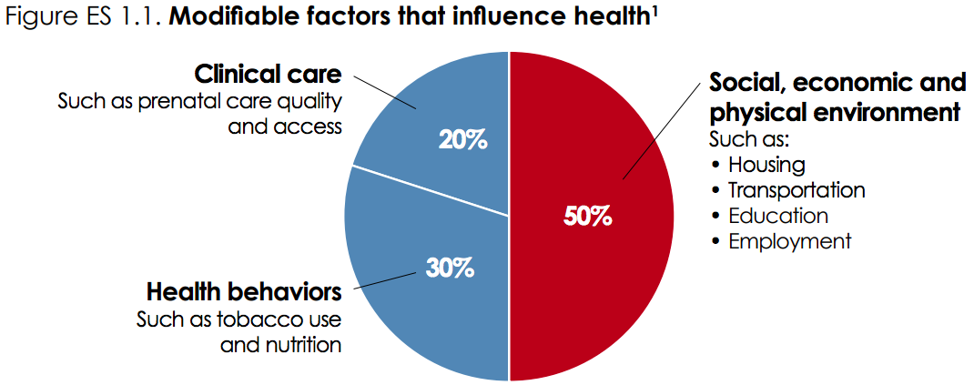

Slide 8
Underlying Drivers of Inequity
Racism
Poverty
Discrimination
Trauma
Violence
Toxic stress

Slide 9
127 Recommendations
Notes:
127 policy recommendations

Slide 11
Notes:
Groundwork Ohio is researching and publishing the Ohio Early Childhood Race and Rural Equity Report to bring greater understanding among policymakers and stakeholders of how race and location matters to the policies, institutions and systems that shape the future for children and families in Ohio. Taking action begins with honest and sincere conversations.
Achieving equity for Ohio kids requires all of us to begin to take responsibility for the things we can change by challenging our assumptions, investigating the evidence and recognizing what we don’t yet know.

Slide 12
Viewing Ohio’s Youngest Learners
Through an Equity Lens
Who are we missing?
Where are the gaps?
What is the scope of the problem?

Slide 13
Telling the Full Story
Prenatal Care
Preterm birth rates
Infant mortality
Access to State & Federal Funded Home Visiting
Access to Early Head Start
Early Childhood Poverty
Incidence of Trauma
Early Intervention
Access to Publicly Funded Childcare
Access to Head Start
Access to Preschool
Access to Early Childhood Experiences
Kindergarten Readiness
Access to Healthcare Coverage
Oral Health
Incidence of Lead
Incidence of Asthma
Childhood Obesity
Third Grade Reading Proficiency
Early Childhood Suspension and Expulsion
Special Education
Juvenile Justice
Eight Grade Math Achievement
High School Graduation
Postsecondary Attainment

Slide 14
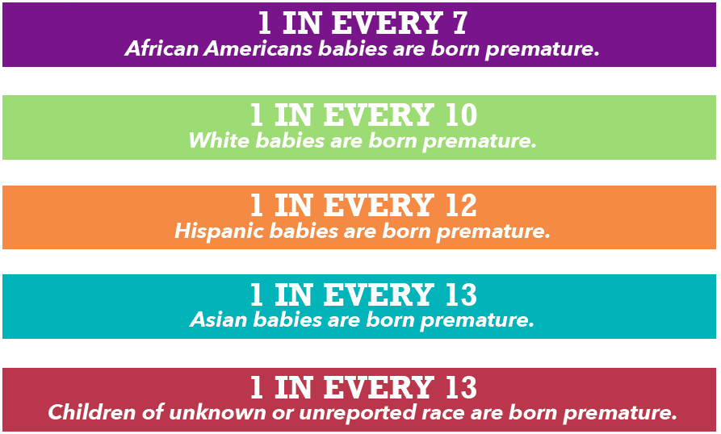
Preterm Birth
2016 Preterm Birth Rate by race.

Slide 15
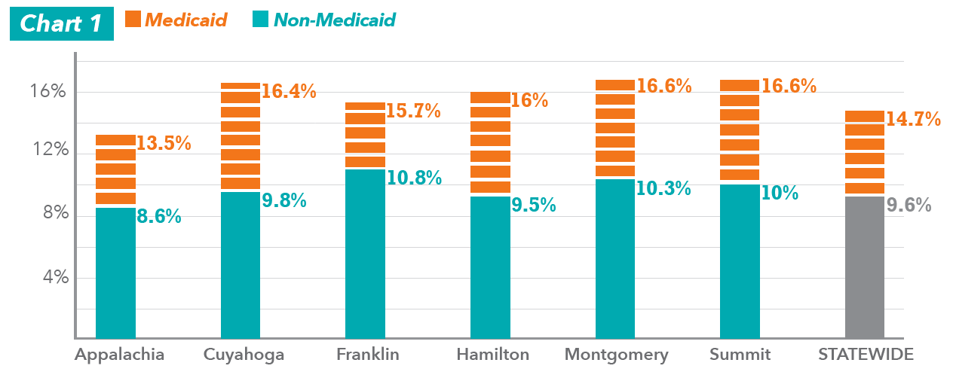
Preterm Birth
2016 Preterm Birth Rate for Medicaid & Non-Medicaid Patients in Ohio & Selected Regions
Notes:
Add year

Slide 16
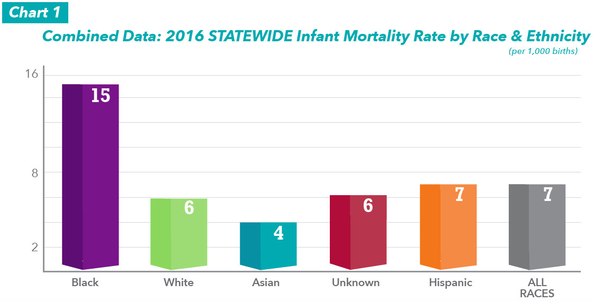
Infant Mortality

Slide 17
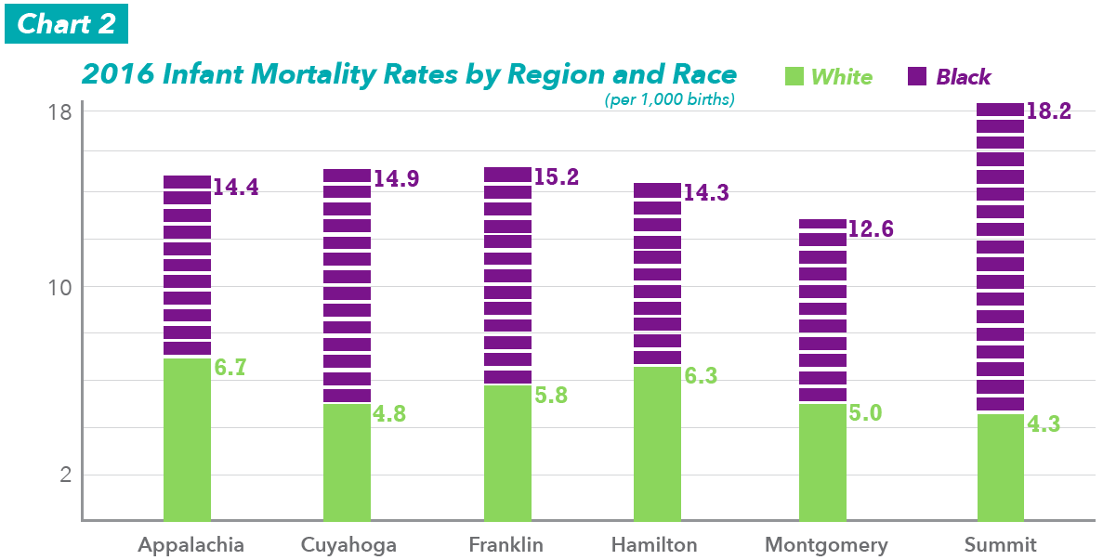
Infant Mortality

Slide 18
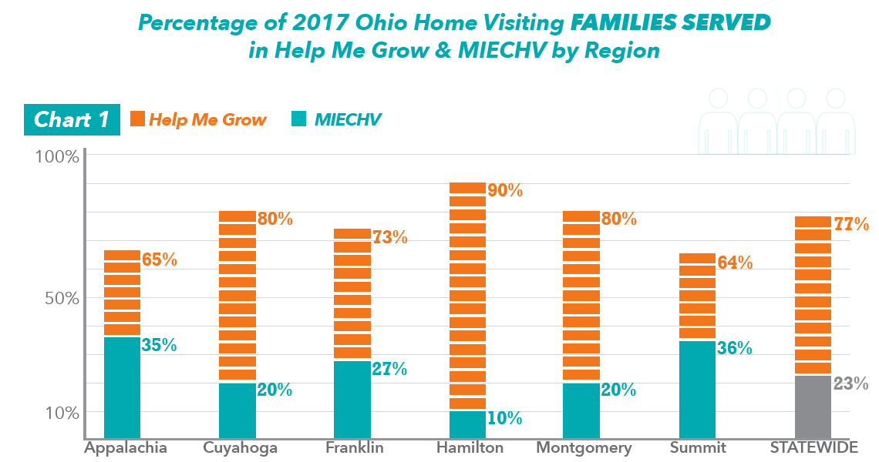
Access to Home Visiting

Slide 19
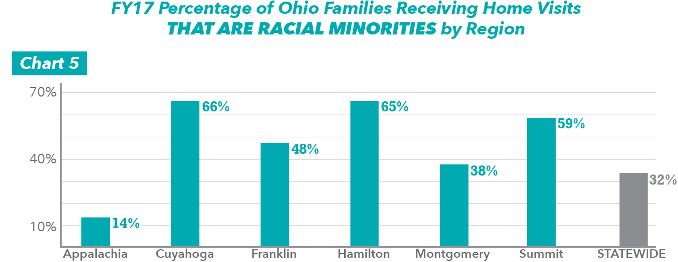
Access to Home Visiting

Slide 20
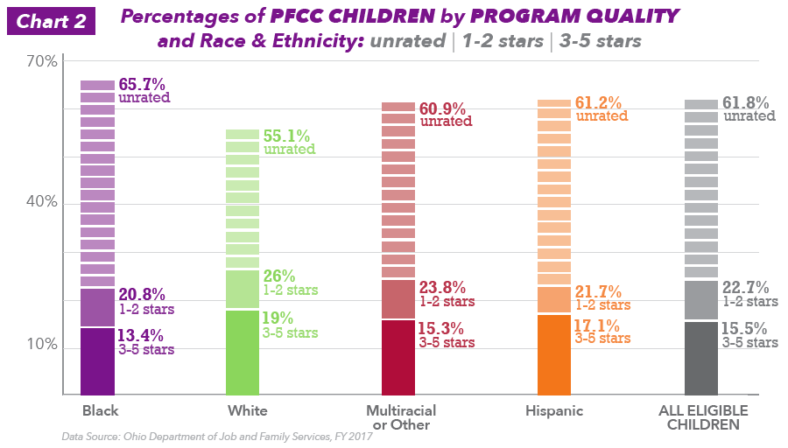
Access to Quality Child Care

Slide 21
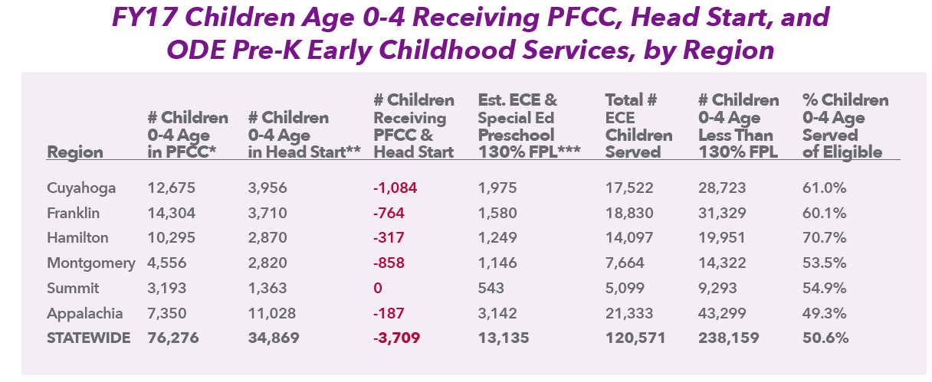
Access to an Early Childhood Program

Slide 22
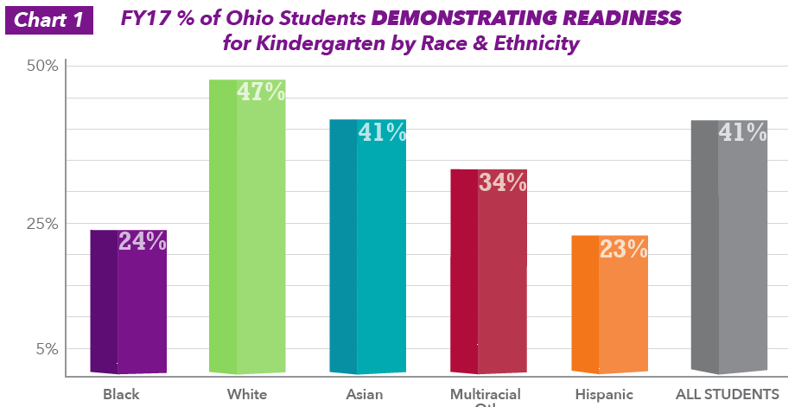
Kindergarten Readiness

Slide 23
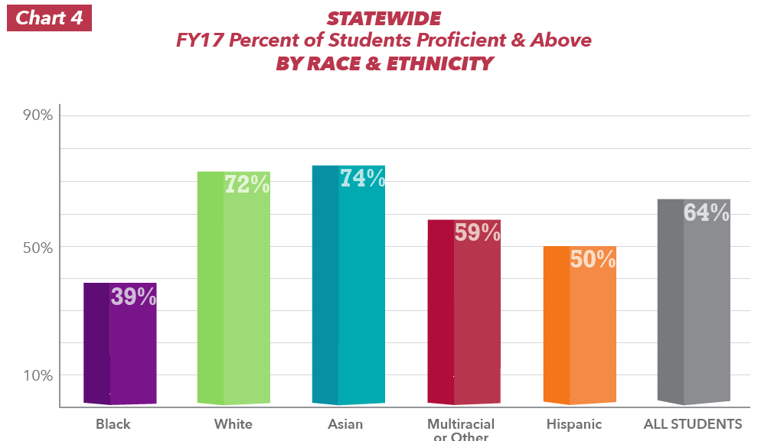
Third Grade Reading

Slide 24
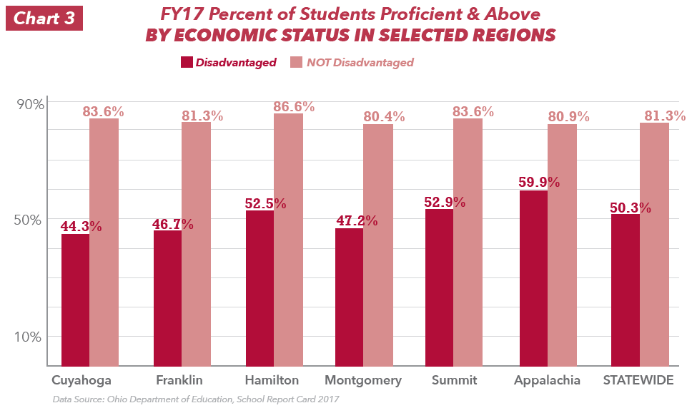
Third Grade Reading

Slide 25
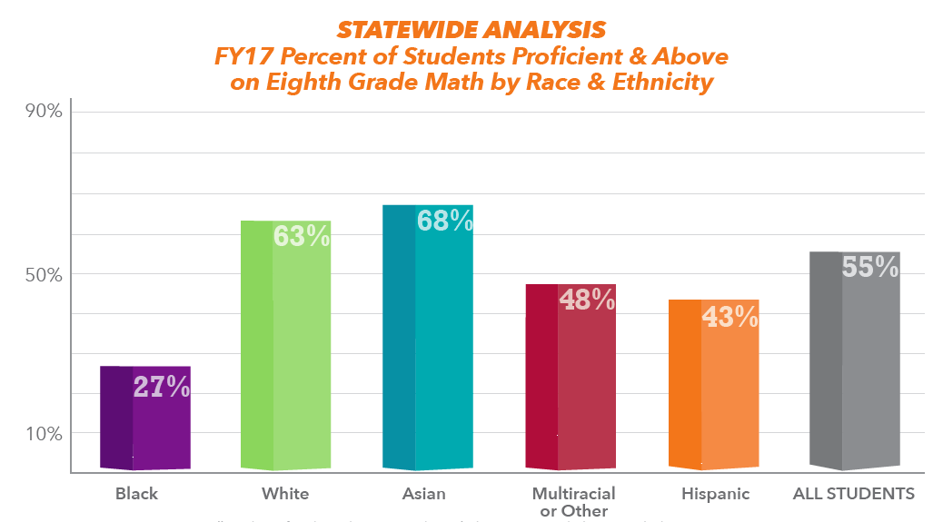
Eighth Grade Math

Slide 26
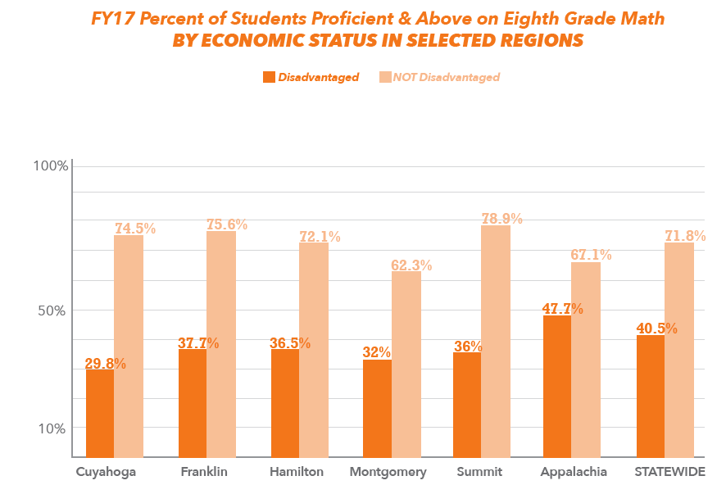
Eighth Grade Math

Slide 27
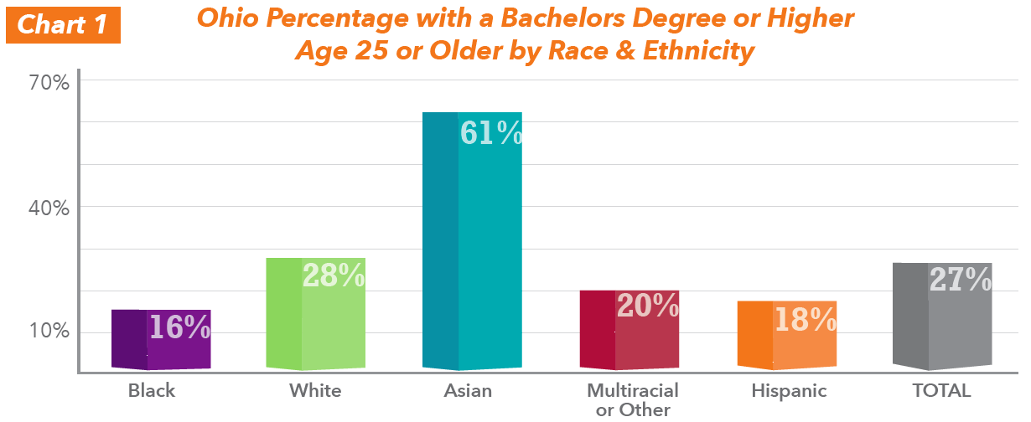
Post-Secondary Attainment

Slide 28
Why invest in early education?

Slide 30
THANK YOU!
To learn more, visit
www.GroundworkOhio.org
@GroundworkOhio

