Slide 1
Ohio Association of Community Health Centers
Commission on Infant Mortality
December 3, 2015

Slide 2
Ohio Association of Community Health Centers (OACHC)
Professional organization representing Ohio’s Federally Qualified Health Center (FQHC) and Look-Alike (FQHC-LA) networks
45 FQHCs in Ohio (includes FQHC-LAs).
Healthcare home and family doctor for more than 573,000 Ohioans annually.
Providing high-quality, affordable, primary and preventive health care and care management services regardless of insurance status or ability to pay.
250 locations in 64 of Ohio’s 88 counties

Slide 3
Patient Race, Age & Sex

Slide 4
Patient Income & Insurance

Slide 5
Medicaid and Uninsured Patients in Ohio FQHCs 2013-2014

Slide 6
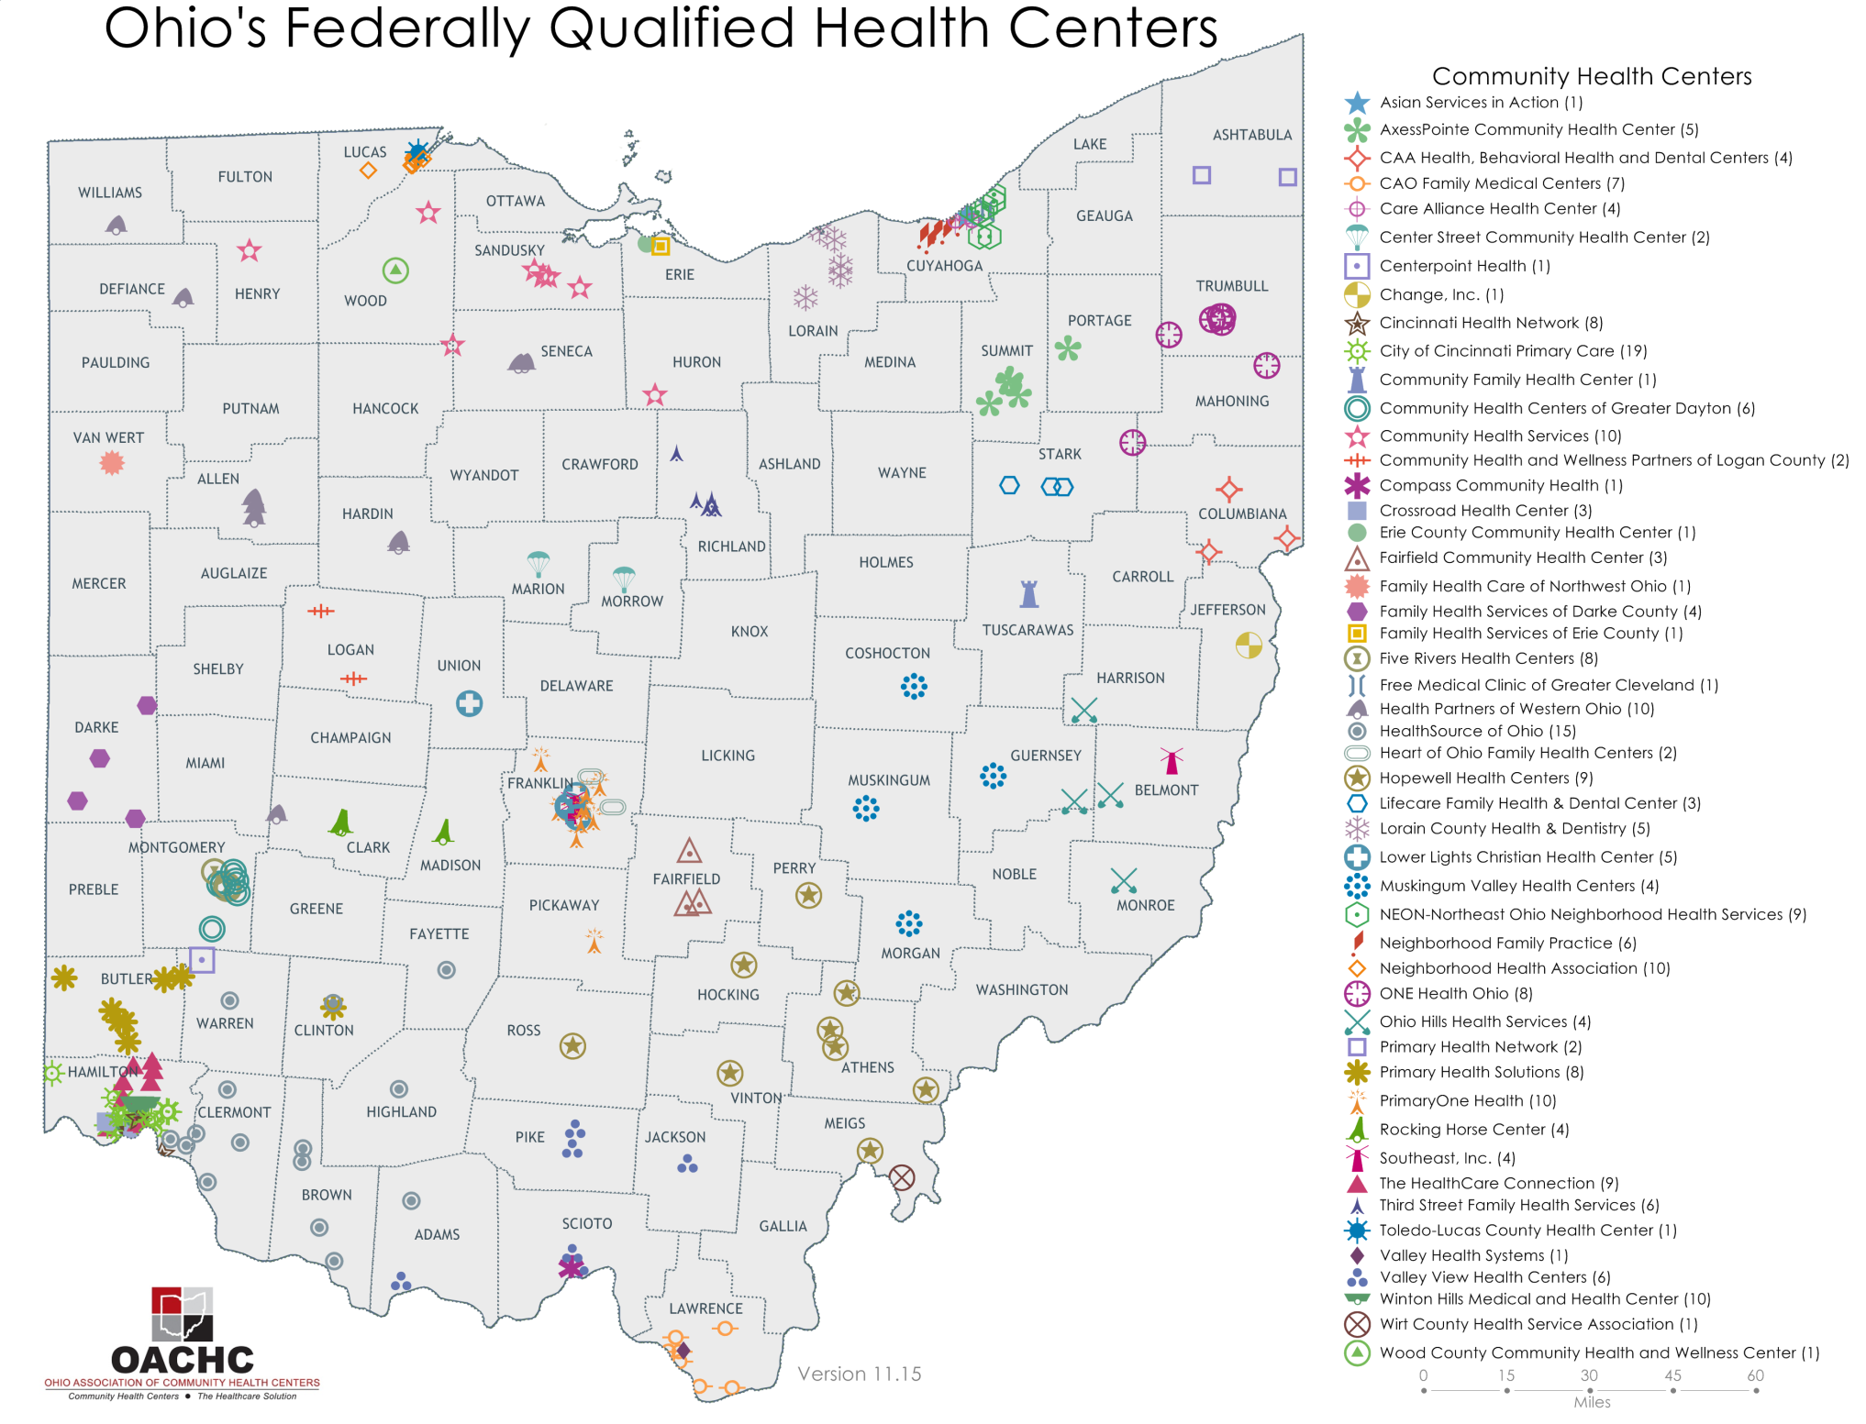

Slide 7
FQHC Required Services
Primary
Preventive
Enabling
Other
Diagnostics
Screenings
Emergency Medical Services
Family Planning
Immunizations
Well Child
Gynecology
Obstetrics
Pre/perinatal
Preventive Dental
Mental Health
Substance Abuse
Specialty
Pharmacy
Case Management
Health Education
Outreach
Transportation
Translation
Required services must be provided on-site or through established written agreements and referrals.
Homeless grantees must provide substance abuse services

Slide 8
Types of Providers
Provider Types | FTEs | Total
Primary Care Physicians | 174.94 | 211
OB/GYNs | 21.75 | 35
Pediatricians | 55.93 | 68
Dentists | 91.18 | 120
Psychiatrists | 6.51 | 9
Psychologists | 3.28 | 3
Optometrists | 5.85 | 7
Physician Assistants | 14.95 | 16
Nurse Practitioners | 167.05 | 233
Certified Nurse Midwives | 18.47 | 27
LISWs | 51.35 | 60
Nurses | 446.46 | 572
Dental Hygienists | 46.58 | 65

Slide 9
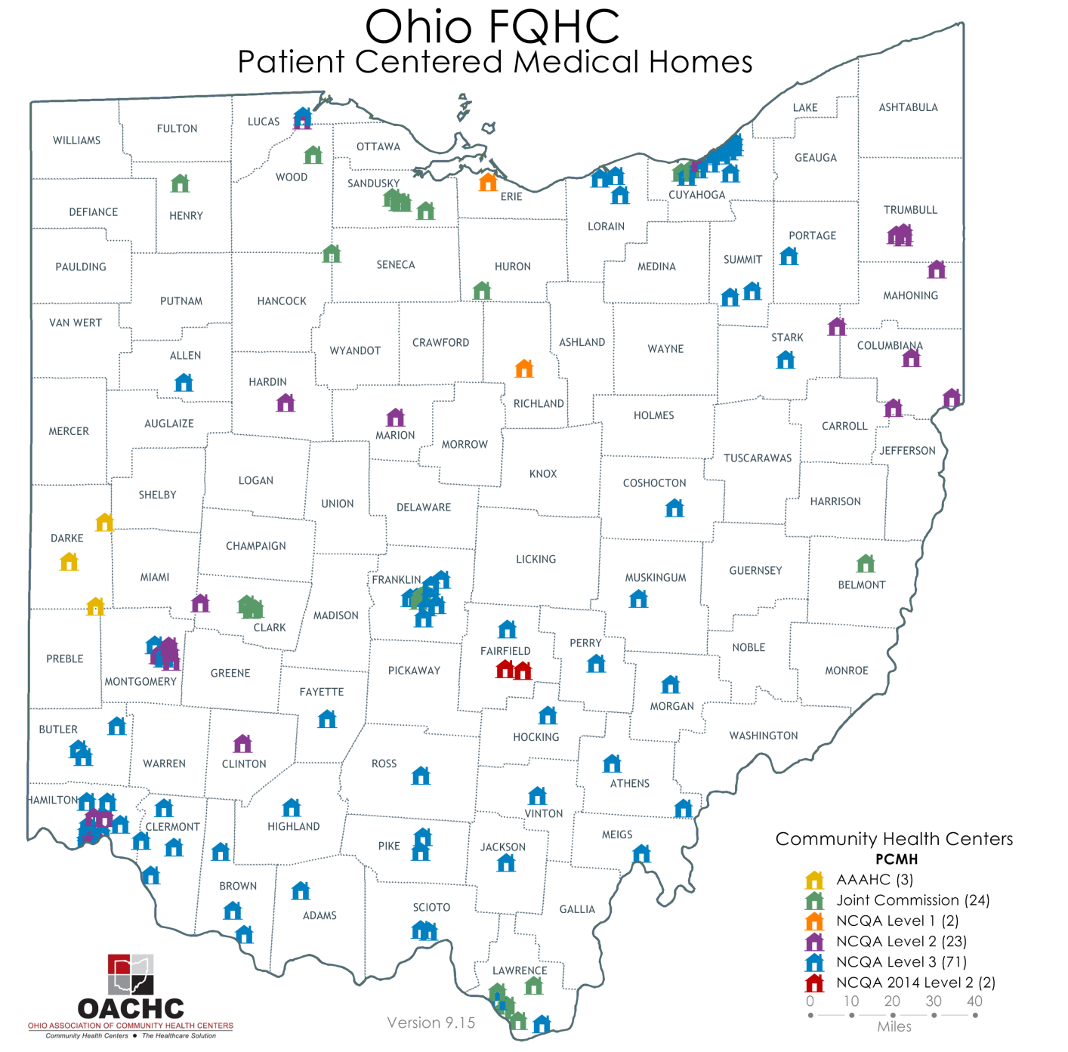

Slide 10
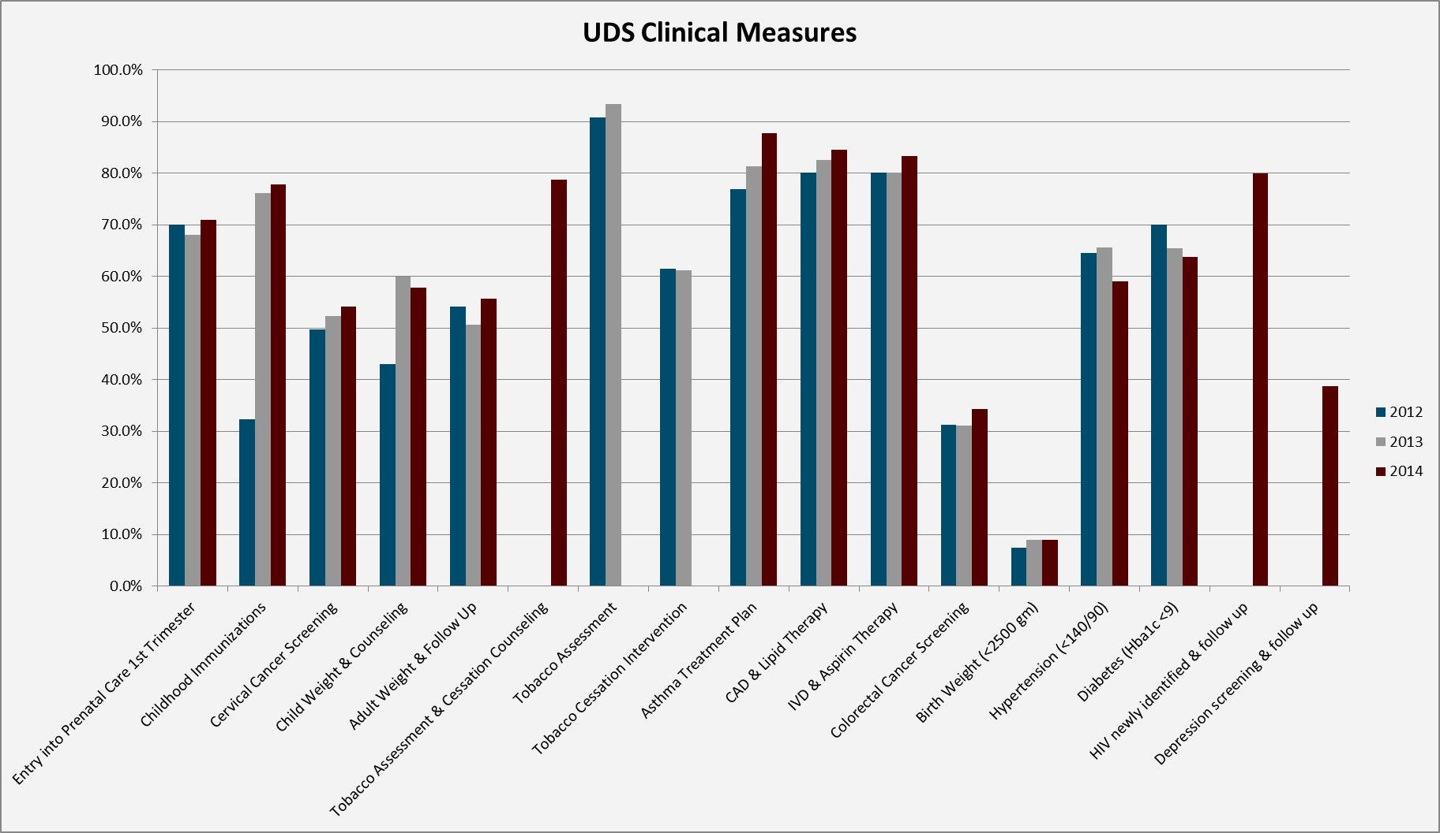
3-Year Statewide Comparison

Slide 12
Survey Themes
LARCs :: 17-P :: Safe Sleep

Slide 13
Survey Methodology
Sent statewide to 45 FQHCs
43 responses representing minimum of 28 organizations
Please note, not all respondents answered all questions

Slide 14
LARCs
93% discuss LARCs as family planning option
81% provide LARCs onsite
Best Practices
Same day procedure with office visit
LARC education packets available at all sites
Contraception and pregnancy spacing routinely discussed by provider
Make affordable to uninsured patients
Other
Popularity among young women has grown substantially
Routinely ask all reproductive age females if they plan to become pregnant in the next year; educate on birth spacing options

Slide 15
LARCs
Barriers (27 responses)
cost/reimbursement – 59%
insurance coverage – 41%
patient attitude – 22%
availability – 19%
provider attitude – 4%
medication shelf life – 11%
no barrier – 15%
Additional Feedback
Providers not trained
Negative attitude of numerous patients’ mothers

Slide 16
LARCs
Recommendations
LARC offered and performed following deliveries and before patient discharged
Same day procedure with office visit
Provide training and proctoring opportunities

Slide 17
Preterm Birth Risk/17-P
81% screen preterm birth risk (22/27)
When preterm high risk is identified:
Transfer all care to outside OB: 36% (8)
Treat in office with 17-P: 32% (7)
Refer for OB consult & manage at FQHC: 18% (4)

Slide 18
17-P
Barriers (17 responses)
cost/reimbursement – 5
insurance coverage – 4
availability – 3
patient attitude – 2
provider attitude – 0
no barrier(s) identified – 2
Additional Feedback
Time intensive to get progesterone (on average 6 attempts)
1 full hour of provider/patient
Availability has decreased over the last 6 mos causing significant reduction in implementation

Slide 19
Safe Sleep Practices
93% routinely instruct (25/27)
Recommendations
Healthy Start
Sleep sacks
Crib for Kids
Centering Parenting
Social Services
Community outreach promoting Safe Sleep/SIDS awareness

Slide 20
Sample of Other IM Interventions Reported
Tobacco Cessation
Substance Intervention Programs (including tobacco, heroin, opiate, & alcohol use)
Breastfeeding Policies and Support
Centering Pregnancy; parent/infant education classes

Slide 21
Addt’l Survey Themes
Provider education; critical role(s) to play regardless of prenatal care delivered onsite
Global health system needs to co-manage patients better
Standardize practice guideline adherence using EMR templates

Slide 22
Other Recommendations from Survey
Reimburse Community Health Workers
Expand Centering Pregnancy and Centering Parenting
Funding to support evidence based practices and innovative practices
Stronger linkages w community partners/social service agencies re SDH
Add staff to connect with women (pre-pregnancy, early entry)
Safe sleep education at all immunization visits <12 months; depression screen moms at all well child visits <12 months
Routinely ask “do you plan to get pregnant in the next year?”

Slide 23
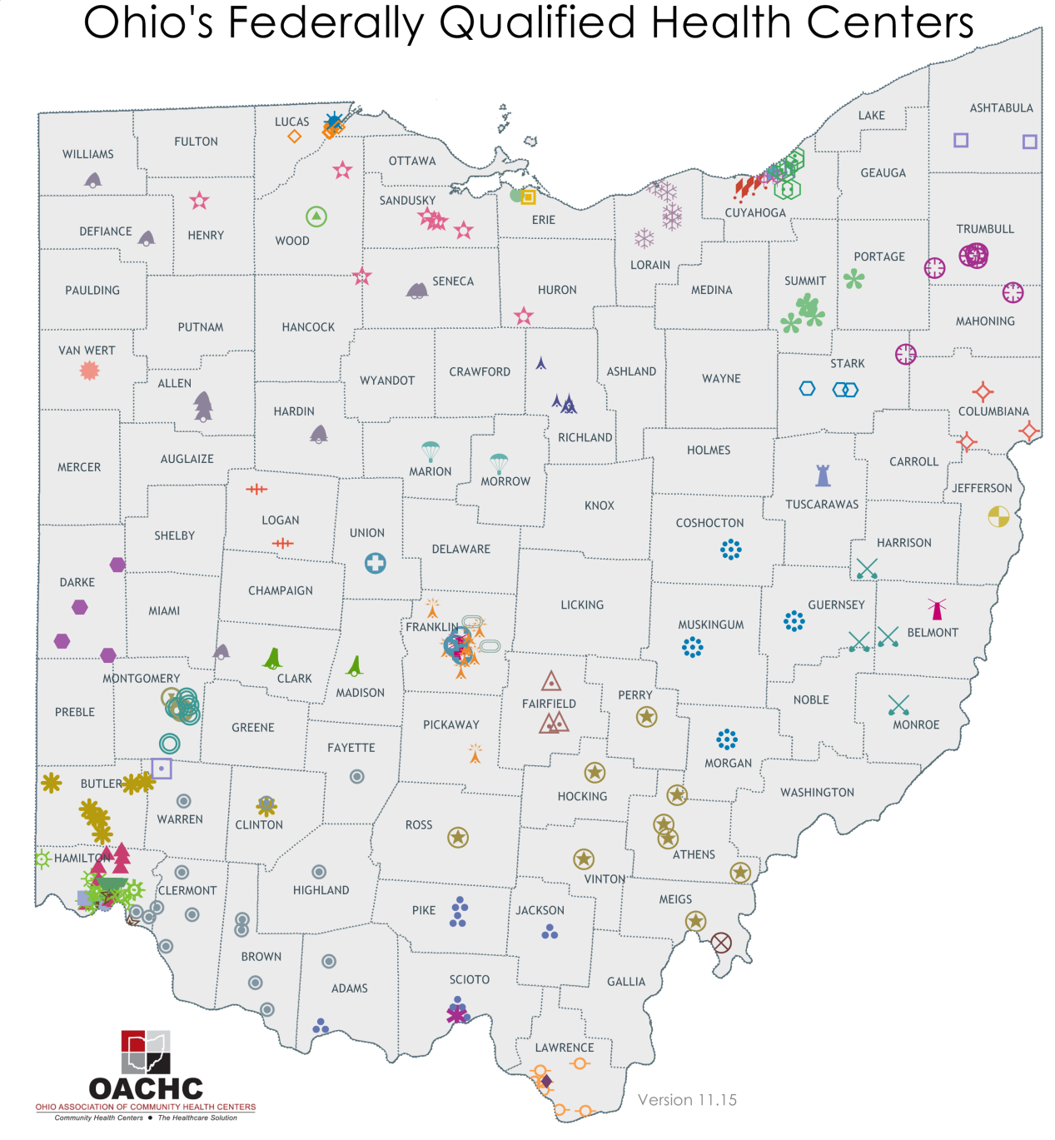
Thank You!
For additional information please visit the OACHC website at www.ohiochc.org
OACHC
4150 Indianola Avenue
Columbus, 43214
614.884.3101
Julie DiRossi-King
COO
jdirossi@ohiochc.org
Dr. Ted Wymyslo
CMO
twymyslo@ohiochc.org

