Slide 1
Infant Vitality Initiatives
Julie DiRossi-King, Chief Operating Officer
Dr. Ted Wymyslo, Chief Medical Officer

Slide 2
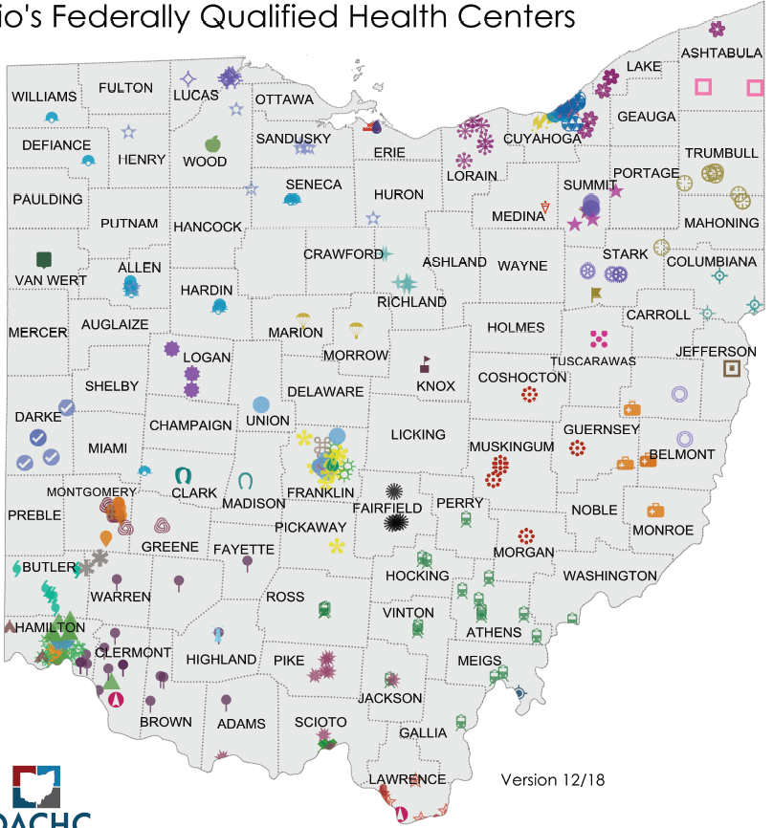
Ohio Community Health Centers
55 Community Health Centers in Ohio
330+ locations statewide
69 of Ohio’s 88 counties
Healthcare home and family doctor for more than 780,000 Ohioans annually (2018 preliminary data)
Notes:
A brief background on Ohio: it’s political landscape, its players and our FQHCs so you can have a little insight on why we chose a stateside response.
Ohio now has 55 FQHCs comprised of 330+ sites and providing care to nearly 800K Ohioans.

Slide 3
Our Health Center Reach
In 2017, served (annually)*
14,000+ pregnant women
Nearly 16,300 infants
197,000+ women of childbearing age (20% increase from 2016)
*Source: 2017 UDS data

Slide 4
OACHC Current Initiatives
17-Progesterone
CenteringPregnancy
Injury Prevention/Safe Sleep
LARC Access Ohio
OACHC Infant Mortality Taskforce
OCPIM
Smoking Cessation/Smoke-Free Families
Birth Spacing (FQHC Infant Vitality Initiative) – CAI & OPQC

Slide 5
Ohio FQHC Infant Vitality Initiative
To improve infant vitality and maternal health by empowering women with information and services to optimize timing and spacing of their pregnancies
To improve patient care and outcomes by training teams on evidence-based clinical practices, long-acting reversible contraceptives (LARC) stocking and financing, workflow, and contraceptive counseling
Notes:
The Ohio Perinatal Quality Collaborative (OPQC) partnered with Cicatelli Associates Inc (CAI), the Ohio Association of Community Health Centers (OACHC) the Ohio Department of Medicaid (ODM) and the Ohio Colleges of Medicine Government Resource Center (GRC) to implement the “Infant Mortality Reduction-Federally Qualified Health Centers” project. The aim of this initiative was to improve infant vitality and maternal health by empowering women with information and services to optimize timing and spacing of their pregnancies. The project involved nine clinical sites of five FQHC networks. The Client-Centered Care framework we used, developed with CAI and OPQC content and implementation expertise, aimed to improve patient care and outcomes by training teams on evidence-based clinical practices, long-acting reversible contraceptives (LARC) stocking and financing, workflow, and contraceptive counseling.

Slide 6
Client-Centered Contraceptive Care Model
Healthcare providers have systems and processes in place to:
identify women in need of contraceptive services at every visit,
ensure that they have accurate and unbiased information about all FDA-approved contraceptive methods,
employ a shared decision-making approach to contraceptive counseling and, if clinically appropriate,
provide or prescribe a woman’s contraceptive method of choice on the same day of the visit

Slide 7
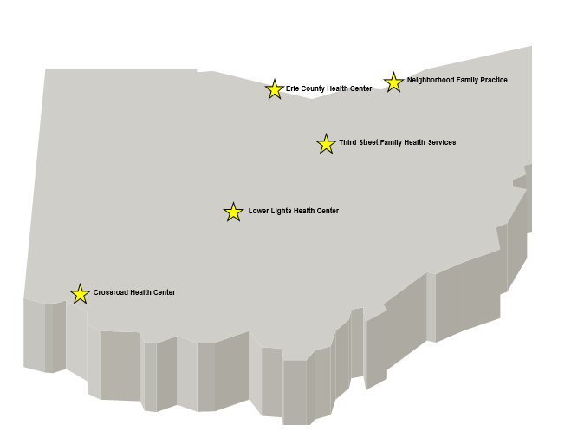
Participating Sites
Five (5) Community Health Center networks consisting of nine (9) total sites

Slide 8
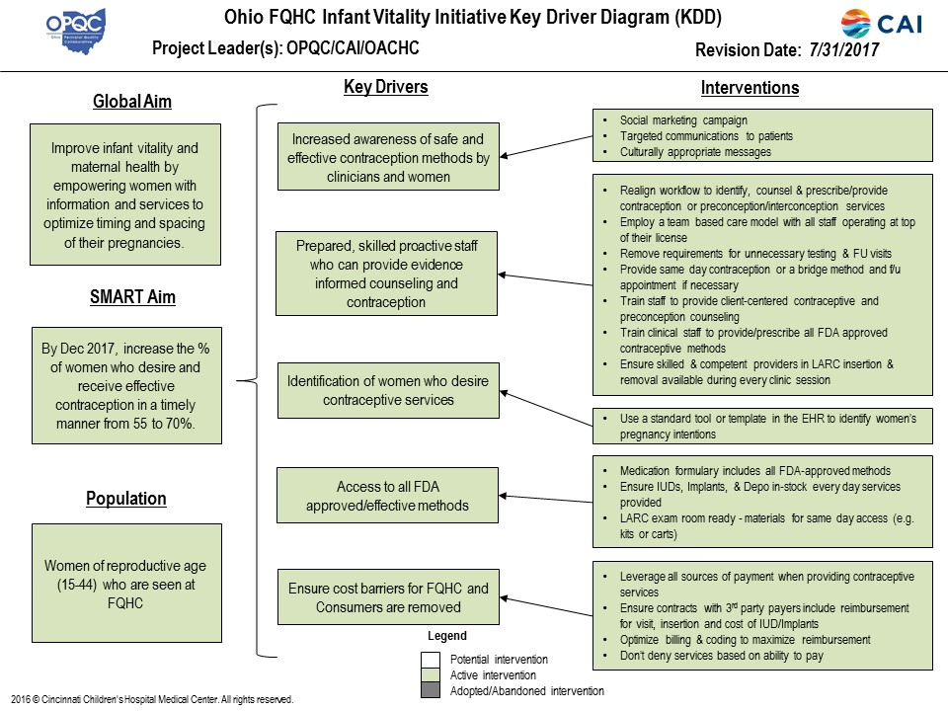

Slide 9
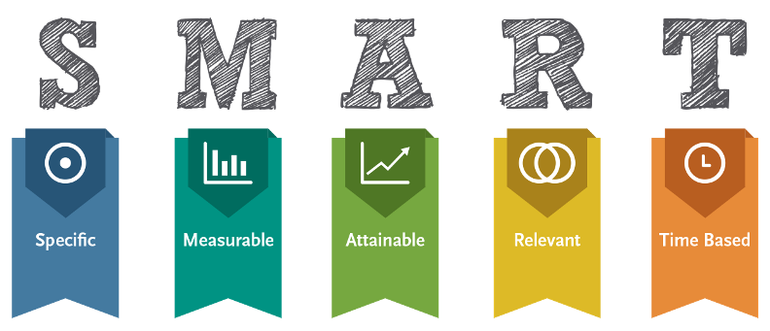
SMART Aim
The SMART Aim: to increase the percentage of women who desire and receive effective contraception in a timely manner from 55% to 70% by December 2017

Slide 10
Screened for Pregnancy Intention
Notes:
Numerator is about 155 patients

Slide 11
Contraceptive Counseling Occurred

Slide 12
Leave with Most Effective Contraceptive

Slide 13
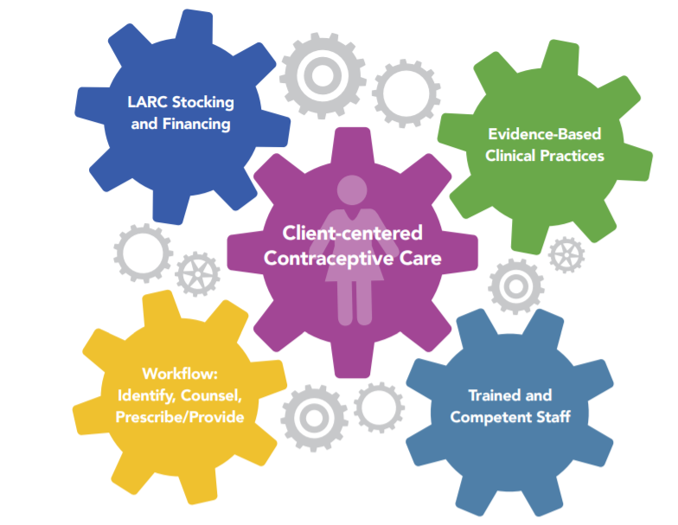
Outcome: Change Package

Slide 14
It IS Possible!
In a client-centered contraceptive case workflow, every woman is:
Asked about her pregnancy intentions
Do you want to be pregnant in the next few months, or have a baby in the next year?
Provided follow-up counseling based on her response
Provided with the contraceptive method of her choice that same day
Notes:
It IS possible to incorporate the Client-Centered Contraceptive Care Model into a practice workflow

Slide 15
Landscape Today: Successes
Reproductive Life Plan: full spectrum of contraceptive services, abstinence education
Patients provided with their contraceptive method of choice or a short-term bridge prior to IUD insertions
Expanded the program to more sites
Learned insurance/billing protocols for LARC
Partnered with ODM/MCPs to support LARC billing (viable and sustainable)

Slide 16
Landscape Today: Challenges
Need additional providers trained on all insertion devices and techniques
Some providers have religious objections to contraception
Only one center was able to incorporate the “One Key Question” into their EHR
Incorporating into the center’s daily workflow remains a challenge

Slide 17
Opportunities
Spread the proven model
Training
Proven success leads to more buy in
Incorporate the “universal question/one key question” in EHR
Community Education

Slide 18
Questions Please!
Julie DiRossi-King, COO | jdirossi@ohiochc.org
Dr. Ted Wymyslo, CMO | twymyslo@ohiochc.org

